Slide 1
MALI: Community Based Surveillance (CBS) enabling continuous data collections at sites with high security risk
Libasse Gadiaga
PMI VectorLink Project
Mali

Slide 2
Outline
Background
PMI VectorLink Mali’s option to use CBS
Process and implementation of CBS survey
Results and lessons learned
Challenges and recommendation
2021 CBS extension

Slide 3
Background of indoor residual spraying (IRS) and entomological monitoring in Mali (1)
LLIN & IRS the two mains vector control strategies in Mali
PMI support IRS in the south of Mali since 2008.
Since 2017, IRS and longitudinal entomological monitoring were relocated from the south to the central (Mopti region) due to the malaria prevalence of 55% compared with 32% nationally.
Firstly, in the North (since 2013) and progressively the central of Mali was facing several serious security issues .
Then, since 2018, it was very difficult to find a safe control site (to assess IRS entomological impact) for Bandiagara, Bankass and Mopti due to insecurity.

Slide 4
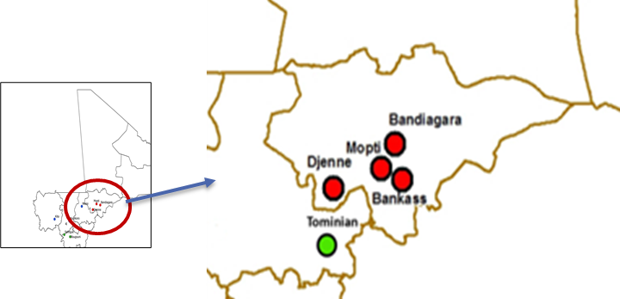
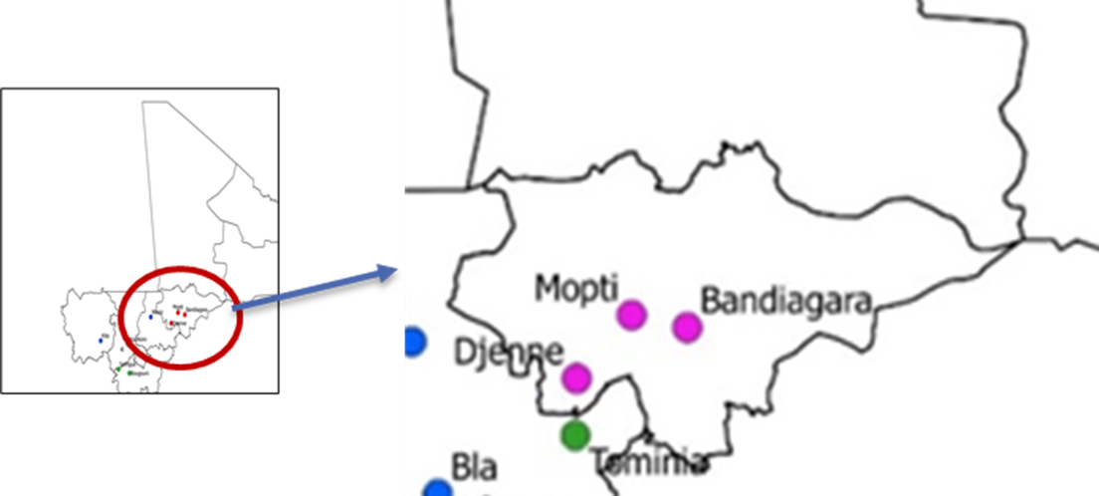
Background of indoor residual spraying (IRS) and entomological monitoring in Mali (2)
2018 (Annual report map)
2019 (Annual report map)
In 2019, due to the security issues and budget reduction, Bankass was also removed from the list of IRS sites.
- For example, in 2019 “Five villages in the health area of Kendie were not sprayed for security reasons, resulting in a massive population displacement and disabling IRS”.
The districts of Mopti, Bandiagara and Djenné were sprayed and surveyed since 2019.
To date, it still not possible to conduct human landing catches in three IRS districts due to high security risk.

Slide 5
PMI VectorLink Mali’s option to use Community Based Surveillance (CBS)
To overcome the security challenges, VectorLink Mali and NMCP started a community-based surveillance (CBS) monitoring pilot in 2020 in the IRS districts located in the Mopti region
(central Mali)
Criteria for site selection
Security and or accessibility restrictions
Good collaboration of the Health Center Technical Directors (CTDs) and the district team with VectorLink Mali activities
CTDs and community leadership buy-in
Local population support for the CBS concept
Criteria for community collector selection
Available, dynamic and motivated
Accepted by the populations (identified by CTD and leaders)
Read and write in French
Speak at least one local language
Notes:
Challenge of engaging women?

Slide 6
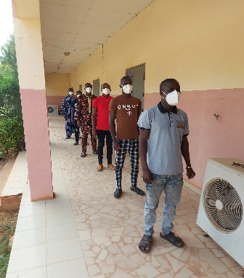
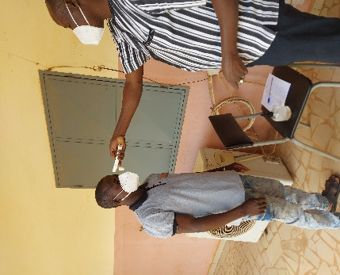
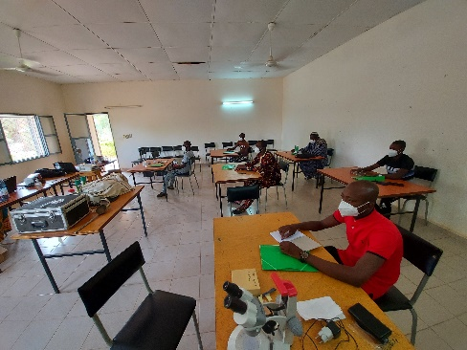
Training of Community Collectors
Training modules (2020)
Methods and procedures for CDC light traps collection
Morphological identification of mosquito genus (separation of Anopheles from other mosquitoes)
Completion of data forms
Storage of mosquito samples
Training modules (2021)
Methods and procedures for pyrethrum spray catch (PSC) collection
Collection (methods and procedures) and rearing of An. gambiae s.l. larvae for susceptibility testing
Training modules were adapted by VectorLink Mali Entomology staff to the needs of community collectors
Theoretical and practical training
2021 training session
After the training, VectorLink Mali Entomology staff worked closely in the field with community collectors for 5 days to ensure activities were completed in accordance with the training.

Slide 7
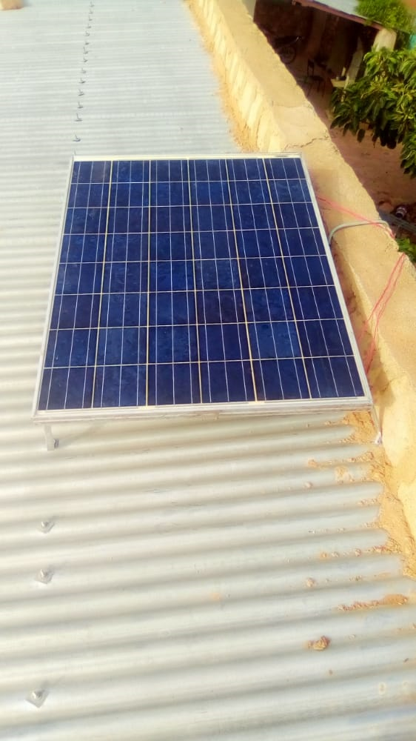
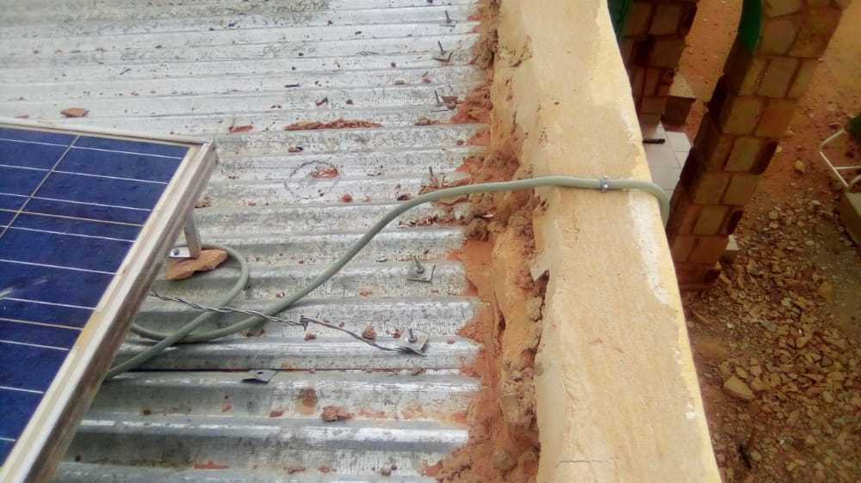
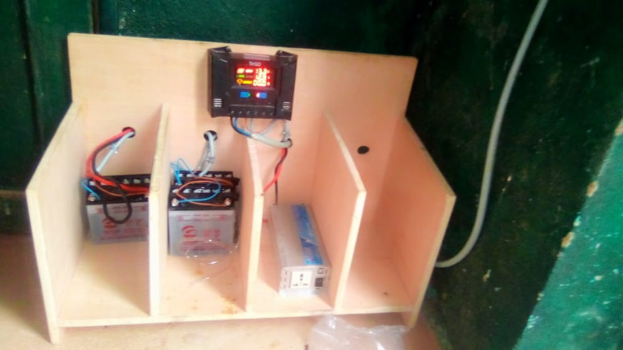
Practical arrangements for Community-Based Surveillance implementation
Need to have continuous energy. Several power cuts were noted in the areas from the national electricity service. We opted to install solar panels in each of our sites to ensure a complete charge of batteries.
CTDs arranged for the recharging of the station and the storage of the materials (CDC-LT, sheets, insecticide aerosols, petri dishes etc.)
CTDs found space in their refrigerator to store collected samples by community collectors until the samples could be sent to the VectorLink Mali entomological technicians for identification and individual preservation in Eppendorf tubes for further laboratory analyses.

Slide 8
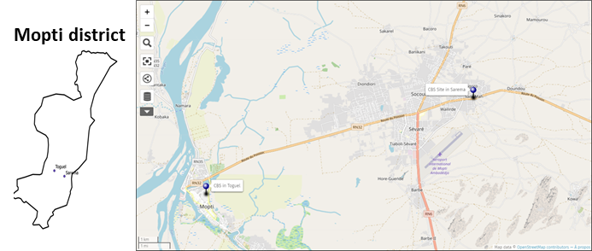
The 2020 Community-Based Surveillance pilot sites and methodology
Sites
Methods
Two sites in Mopti District.
One sprayed site with Fludora® Fusion WP-SB (Sarema)
A non-sprayed village (Toguel). Note that Toguel was sprayed in 2019 with Actellic 300CS.
CDC-LT: 3 traps per night indoors for 20 nights per month (60 houses total per month).
The same 60 houses monitored each month.
PSC: 3 rooms per day for 2 days per week (24 rooms per month).
Collections stored in petri dishes in a refrigerator with all the necessary information (type of method, date, number of the house etc.).
Recording on the paper data collection forms with the same information on the petri dishes.
All preserved samples were recovered by VectorLink staff monthly for further identification and laboratory processing

Slide 9
2020 Community-Based Surveillance pilot results
CDC-LT (August – December 2020)
PSC (June – December 2020)
Mopti District
Sarema sprayed with Fludora Fusion: 5,202 Anopheles mosquitoes collected including 5,186 An. gambiae s.l. (99.7%)
Toguel, Unsprayed site: 5,278 Anopheles mosquitoes collected including 5,267 An. gambiae s.l. (99.8%)
Mopti District
PSC was conducted only in Sarema sprayed with Fludora Fusion: 2,464 An. gambiae s.l. (100%)
Total number of Anopheles collected with CDC-LT (5 months) was two times higher than those collected with PSC in Sarema (7 months).
Diversity of Anopheles collected through CBS using CDC-LT
Ref: 2020 VL Mali Annual Entomology Report

Slide 10
Lessons Learned from 2020 pilot study
Success
Challenge
Field activities performed correctly by community collectors
Community engagement
The broken materials (solar charger, light of trap, etc..) could be repaired by local electrician technicians
A control site was found in and for each IRS site
Data collection completed even in insecured area for CDC-LT
CBS with CDC-LT could be an alternative in area where insecurity causes a lack of close supervision.
Collectors requested to work on other activities by some CTDs, which negatively impacted the CBS
Frequent breakdown of some traps, batteries and charger in some sites
Loss of battery power before the end of the night due to using solar charge station for other needs (charging smartphones, fan, radio etc.)
Huge collection of mosquitoes during the peak of density where it takes more time for identification and storage
Still early to have collectors appropriately complete morphological identification of the mosquitoes, upon the training received
Use of local office equipment such as fridges for mosquito storage with space issues
Difficulty to perform larval collection and rearing
Appropriate allowance enabling to maintain collectors in post for the sustainability of the CBS activities to avoid changing of staff every year

Slide 11
Recommendations
PMI/VectorLink
NMCP Mali
VectorLink has already completed a curriculum for CBS, so need to retrain community collectors and supervisors for approach harmonization
Scaling up capacity for appropriately identifying malaria vectors, codifying and individual preservation
Scaling up capacity to perform larval collection and rearing
Provide all the needed equipment for collection, identification and storage for CBS
Promote CBS for all vector borne diseases
Take responsibilities for the sustainability of CBS activities
Allocate allowance enabling to maintain collectors in post for the sustainability of the CBS activities to avoid changing of staff every year
Recruit a regional entomologist who could follow and provide continuous capacity building for the community collectors through close and periodical supervision and hands-on training
This person will also be very useful for the quality of the data collected by CBS and for testing the ability of the collectors to follow the protocols.

Slide 12
Community-Based Surveillance extension in 2021
Increase collection sites
Due to the success of the pilot study, VectorLink Mali extended CBS to six sites in 2021
Two in each IRS district
One in a sprayed area and another one in an unsprayed area for a control
Increase collection time and houses
CDC-LT: 3 traps per night (indoors) for 2 nights per week (24 houses total per month). The same 24 houses were monitored each month for each site.
PSC: 3 rooms per night per week (12 rooms total per month)
Improve their capacity to perform larval collection
The community-based staff will be closely assisted by VectorLink Mali Entomology staff for their capacity to perform larval collections and rear the larvae to adults for insecticide susceptibility tests

Slide 13
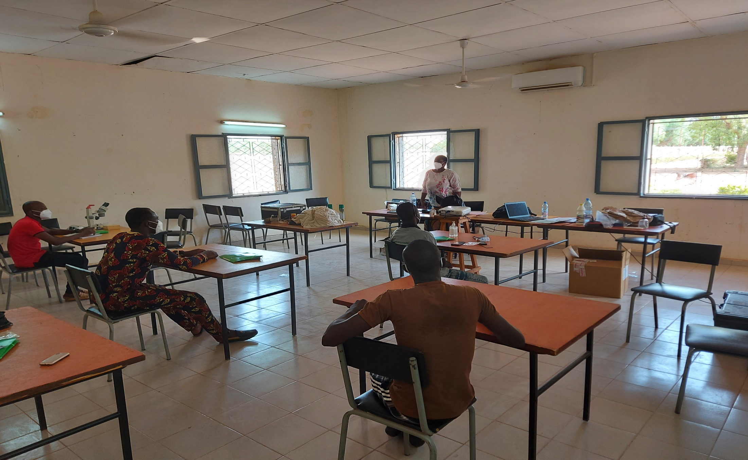
Thank You!

