Slide 1
Urban malaria and An. stephensi in three towns in Ethiopia: molecular and serological evidence
World Mosquito Day; 20 August 2021; Fitsum G Tadesse (PhD)

Slide 2
Notes:
Built on 11 Feb 1893, the Addis Ababa to Djibouti railway provides access to the sea (752km) for a landlocked country Ethiopia. The Afar caravan route also played this important role in the old days and maintains that role currently for local and regional trade.
But now these transportation routes created an opportunity for an invasive mosquito that poses new challenges to the fight against malaria invade the country. This picture is taken at lake Beseka in Metehara, one of the towns invaded by An. stephensi and our study site.

Slide 3
Malaria control in Ethiopia – great achievements
Substantial decline in malaria burden for two decades
In 2005: LLINs, RDT, ACT, CCM
Taffese 2018 Infect Dis Poverty.
Temporally and spatially heterogenous distribution
P. vivax is endemic (~40% of cases)
World Malaria Report 2018

Slide 4
Malaria in Ethiopia – New challenges
Emergence of parasites with hrp2/3 deletion
Emergence of Pfkelch13 in Africa
Spread of insecticide resistance
Invasion of the Horn of Africa by An. stephensi
Feleke 2021 medRxiv
Uwimana 2020 Nat. Med.
Riveron 2018 IntechOpen
Balkew 2020 Par & Vect; Tadesse 2021 Emerg. Infect. Dis.

Slide 5
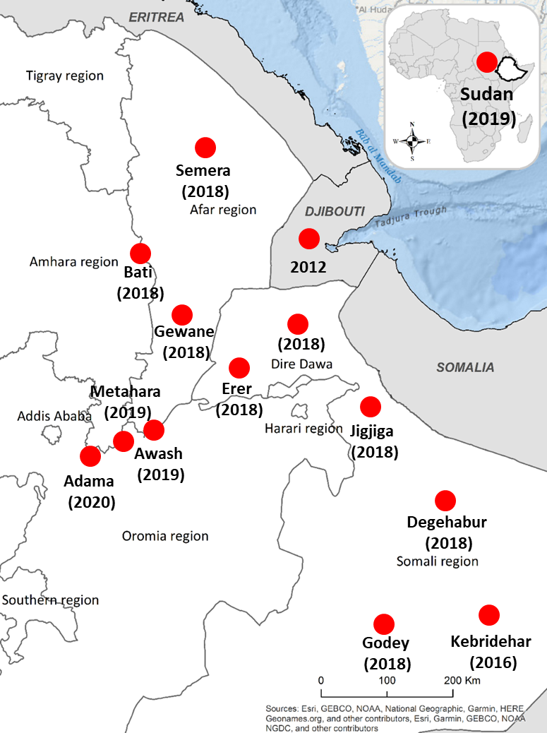
Expansion of An. stephensi in the Horn of Africa
Threat to more than 126 million people in cities across Africa
Malaria incidence increased alarmingly in Djibouti
Since 2015, An. stephensi was reported in 14+23 sites in Ethiopia
Resistant to most classes of insecticides
Highly permissive for Ethiopian P. vivax isolates
2-5 times more permissive than local An. arabiensis
Sinka 2020 Natl Acad Sci USA.
de Santi 2021 Emerg. Infect. Dis.
Balkew 2021 Malar J
Yared 2020 Malar J
Tadesse 2021 Emerg. Infect. Dis.

Slide 6
Characterizing urban malaria: epidemiology and entomology
History of malaria in urban settings
Nationwide surveillance data (2014 - 2019)
Prevalence among urban residents in Adama, Metahara, and Awash Sebat Kilo towns
Cross-sectional studies in 3 towns
Major malaria vectors in urban settings
Longitudinal entomological surveys
Risk factors for malaria infection in urban settings
Water bodies

Slide 7
History of malaria in urban settings in Ethiopia
Nationwide surveillance data (2014 - 2019)

Slide 8
Urban and peri-urban settlements in Ethiopia - 2014
Urban population in Ethiopia: 14%

Slide 9
Trend in urban vs rural malaria in Ethiopia
0.6% RDT in urban settings (rural 1.2%)
Malaria indicator survey (MIS 2015)
18% (range: 16-19%) of the 9.5million malaria cases in the last 6 years

Slide 10
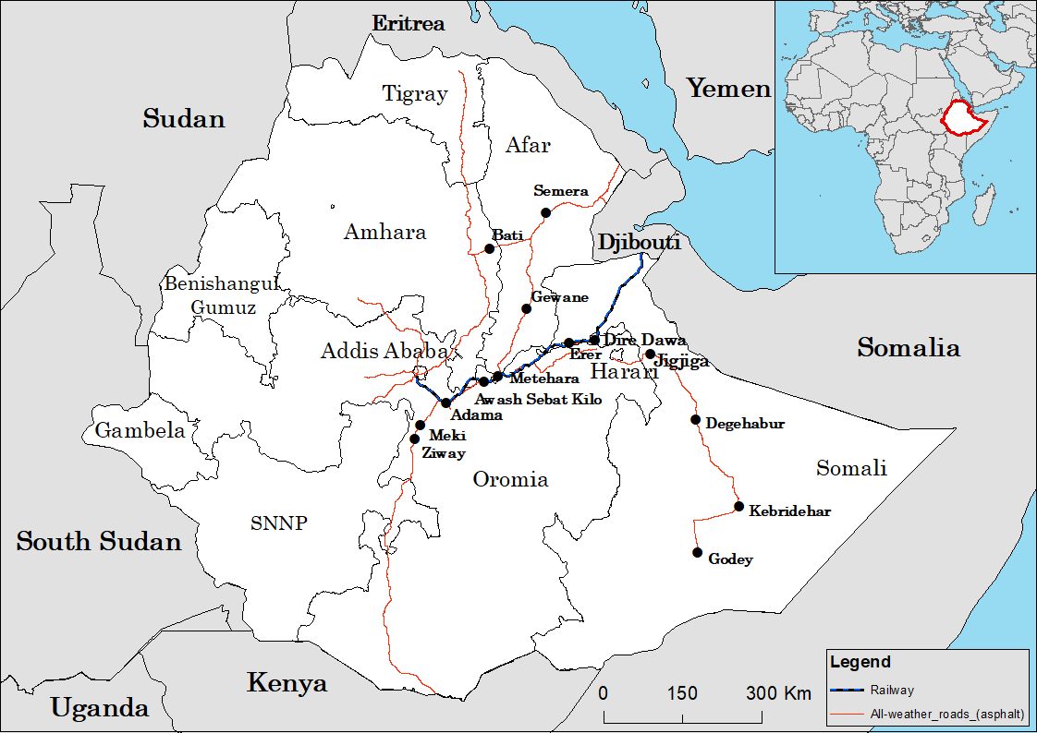
Trend in malaria in 14 towns invaded with An. stephensi
API: 2 – 65 per 1000 population in the 14 towns
No major increase
Semera (API: 12 - 40)
Carter 2018 Acta Trop.
Balkew 2020 Parasite vector
Yared 2020 Malar J
Tadesse 2021 Emerg. Infect. Dis. Balkew 2021 Malar J

Slide 11
Prevalence of malaria among urban and peri-urban residents
Cross-sectional studies in Adama, Metahara, and Awash Sebat Kilo towns

Slide 12
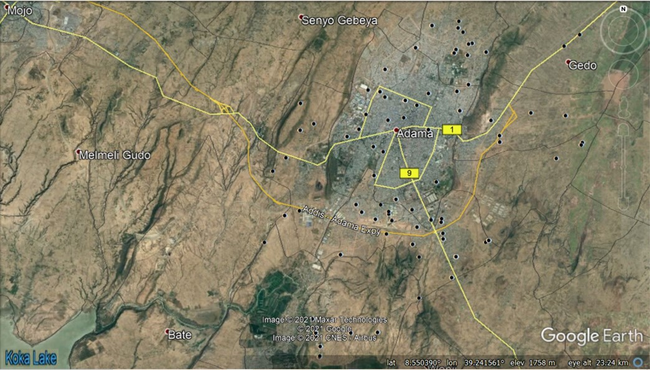
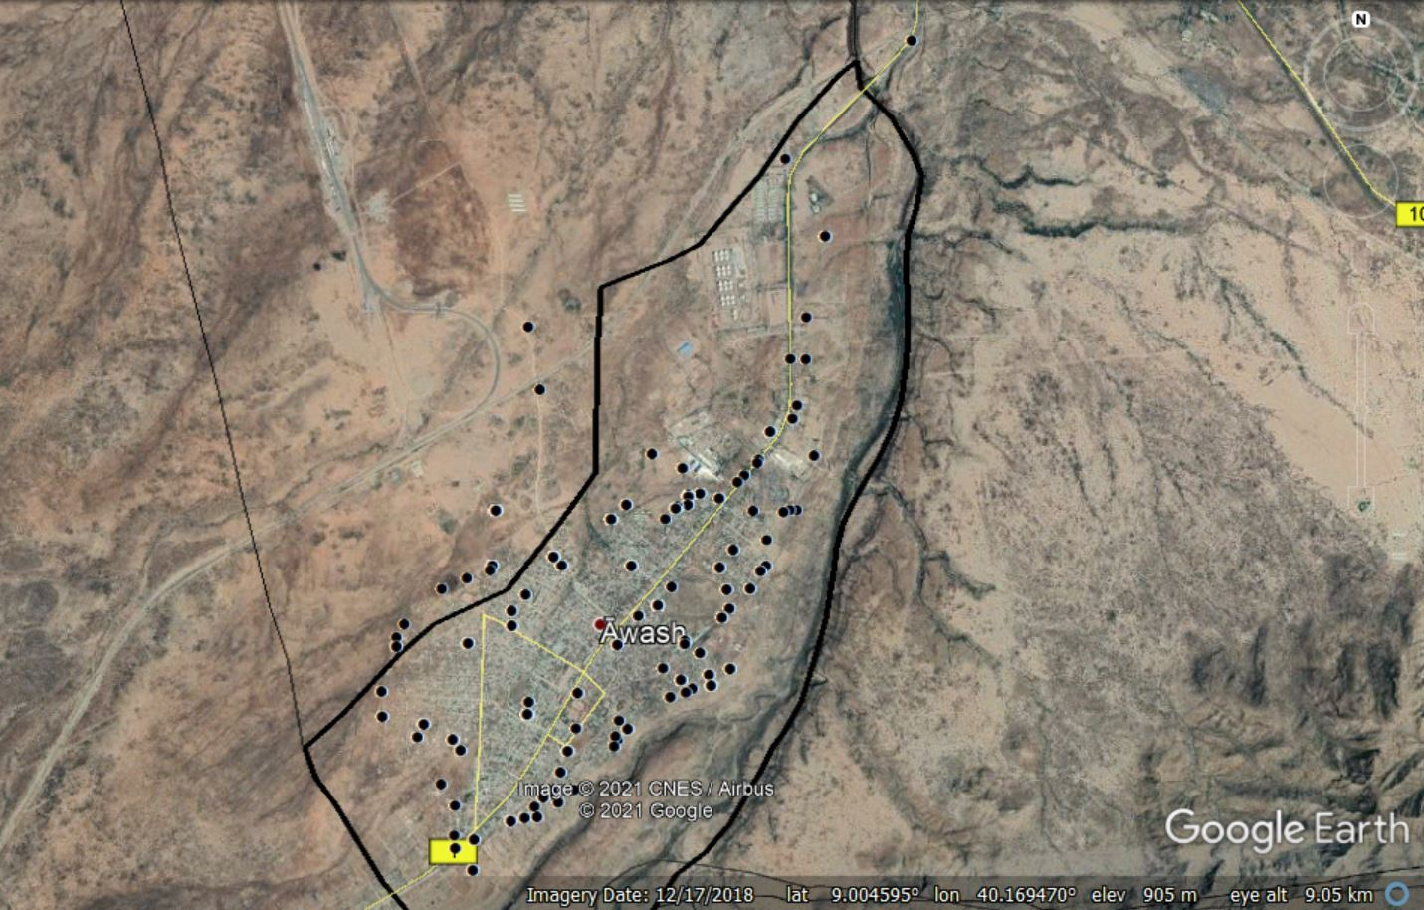
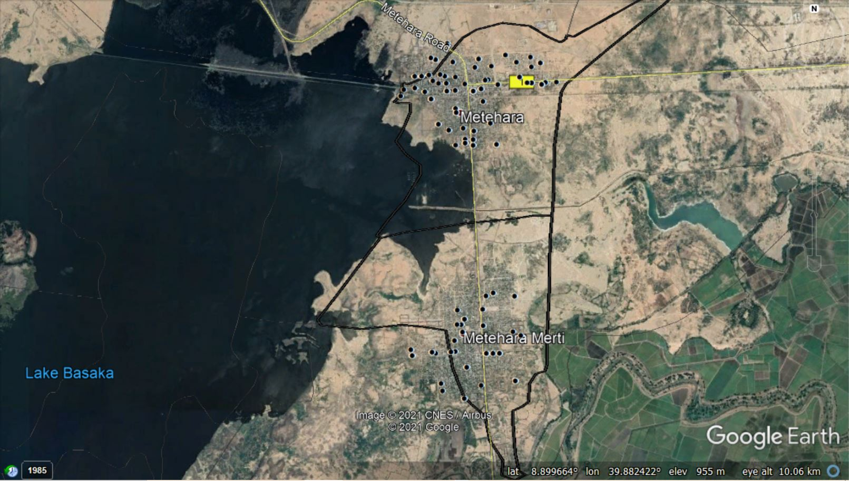
Cross sectional surveys among urban and peri-urban residents
Cross sectional surveys from Jan-March 2020
924 residents from 198 households (66HHs/town)
Median age, 21years (IQR, 9-34)
Adama
Six years average API = 6
Awash Sebat Kilo
Six years average API = 40
Metehara
Six years average API = 72

Slide 13
Transmission of malaria is strongly linked with the rainfall pattern

Slide 14
Asymptomatic low density infections detected in urban residents
Infection prevalence
RDT: <1% (n=6) of participants
18S based quantitative PCR: 22% (n=173); P. vivax = 85%
Adama (28.8%, 74/257), Metahara (20.6%, 53/257), and Awash (17.6%, 46/261)
Asymptomatic low density infections contribute substantially to the infectious reservoir
Intervention utilization
LLIN ownership: 71.7% HHs (Adama 42.9%, Metahara 80.6%, and Awash 90.5%)
IRS in the last 12 months: 8.1% (Adama 6.3%, Metahara 4.2%, and Awash 14.3%)
Towns are not usually targeted
High Chikungunya incidence in Awash
Tadesse 2018 Clin. Infect. Dis.

Slide 15
Neighboring rural villages have high parasite incidence

Slide 16
Major malaria vectors in urban and peri-urban settings
Longitudinal entomological surveys

Slide 17
Longitudinal assessment of bionomics of Anopheles mosquitoes
Bionomics of Anopheles mosquitoes
Indoors, outdoors, and in animal shelters
12 HHs per town for 5 nights per month
From August 2019 – April 2021 (except Jan – June 2020)
Collection methods
Human Landing Catches, CDC light trap, Pyrethrum spray collection, Backpack aspirator, Blackbox, Cattle-baited trap

Slide 18
Longitudinal assessment of bionomics of Anopheles mosquitoes
Total mosquitoes collected (n=2077)
Adama
26 mosquitoes in two monthly surveys
1/15 immature breeding habitats
All were An. stephensi
Most caught outdoor
52.5% An. stephensi
68.8% An. gambiae
82.6% An. pharoensis
Seasonal peak ( July – November)
 | Awash | Metetahara
An. stephensi | 65.1% (244/375) | 7.9% (133/1,676)
An. gambiae | 33.9% (127/375) | 78.6% (1,317/1,676)
An. pharoensis | 1.1% (4/375) | 13.5% (226/1,676)

Slide 19
Plasmodium infection readily detected in wild caught Anopheles
861 salivary glands tested for infection
Infection detected using both CSP ELISA and COX PCR
CSP ELISA: 6.7% (56/861) P. falciparum and 4.3% (36/861) P. vivax
COX PCR: 2.2% (14/673) mosquitoes
In all three mosquito species

Slide 20
An. stephensi mosquitoes feed mainly on animals
Bloodmeal source from Metahara: 229/338
Human – 50 (21.8%)
Cattle – 134 (58.5%)
Dog – 1 (0.4%)
Goat – 4 (1.7%)
Mixed – 40 (17.5%)
Human & Cow – 20 (8.7%)
Cattle & Goat – 15 (6.6%)
Human & Dog – 5 (2.2%)
In Awash Sebat Kilo town: the majority fed on goats (93.3%)

Slide 21
Risk factors for malaria infection in urban settings
Household level environmental factors: aquatic habitat survey
Normalized difference vegetation index (NDVI)
Notes:
proximity to water body by measuring Euclidian distance from breeding sites

Slide 22
Risk factors for malaria infection in urban settings
Proximity to water bodies
Travel to malaria endemic areas
Travel to agricultural areas for labor work
Outdoor activities during mosquito biting hours
Individual HH environmental factors such as NDVI
Euclidian distance from breeding sites
Peterson 2009 AJTMH
Yukich 2013 Malar J.

Slide 23
Conclusion

Slide 24
Conclusion
No evidence for an increase in malaria burden linked with detection of An. stephensi
Slight increase in 2019 (national)
High prevalence of the asymptomatic low density parasite reservoir
High annual parasite incidence in neighboring villages
An. stephensi is the dominating species in two out of the three towns
High infection rate detected in wild caught An. stephensi
Targeted surveillance and intervention is needed to curb potential future outbreak due to the invasive vector An. stephensi

Slide 25
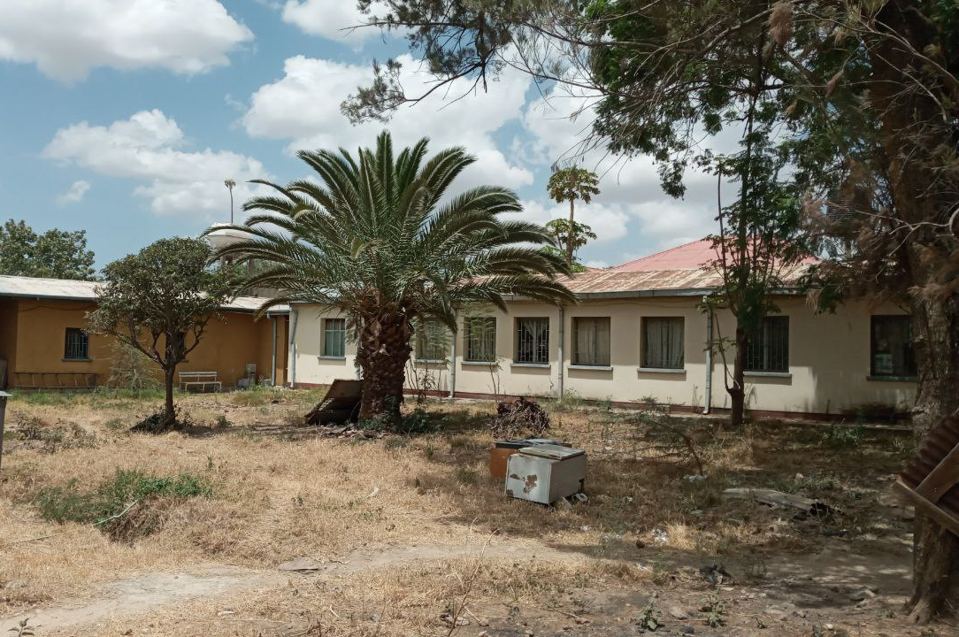
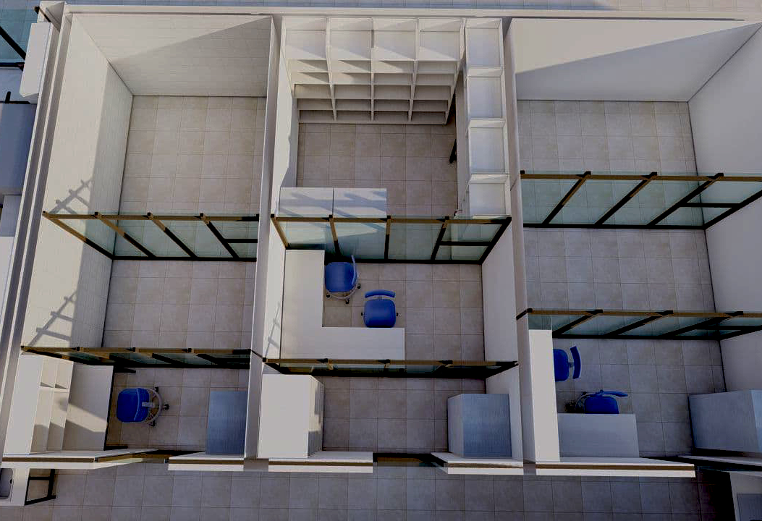
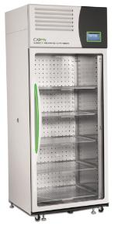
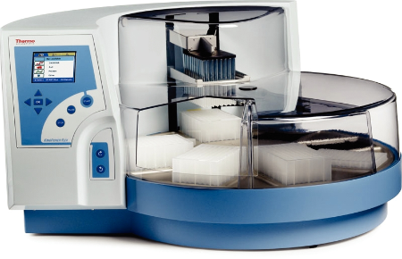
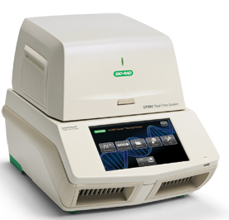
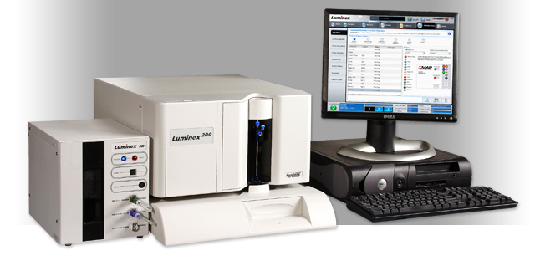
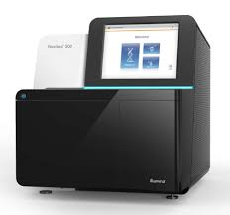
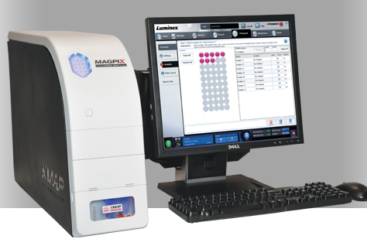
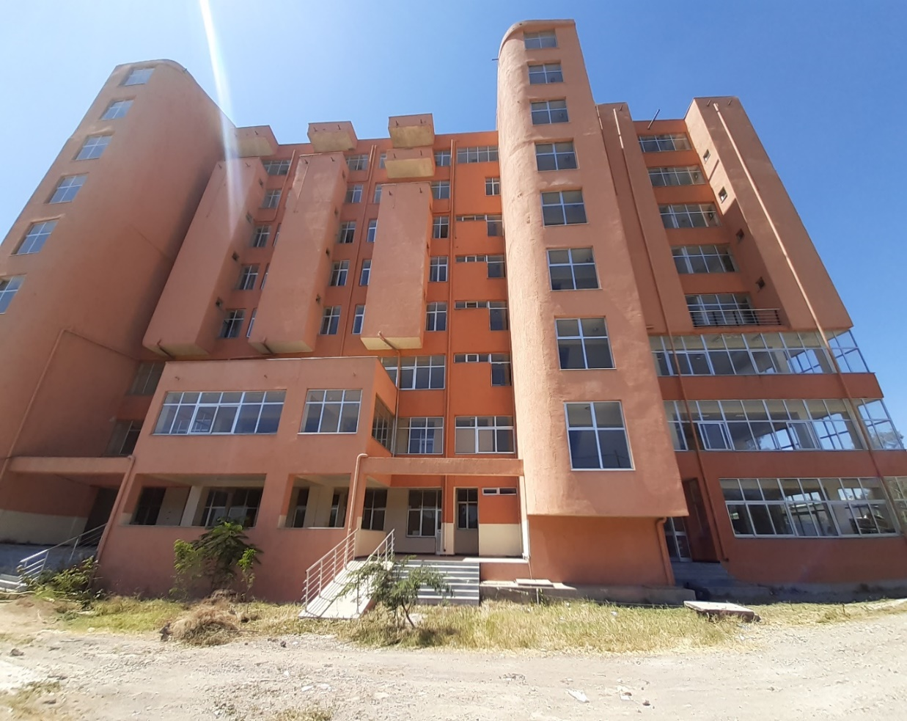
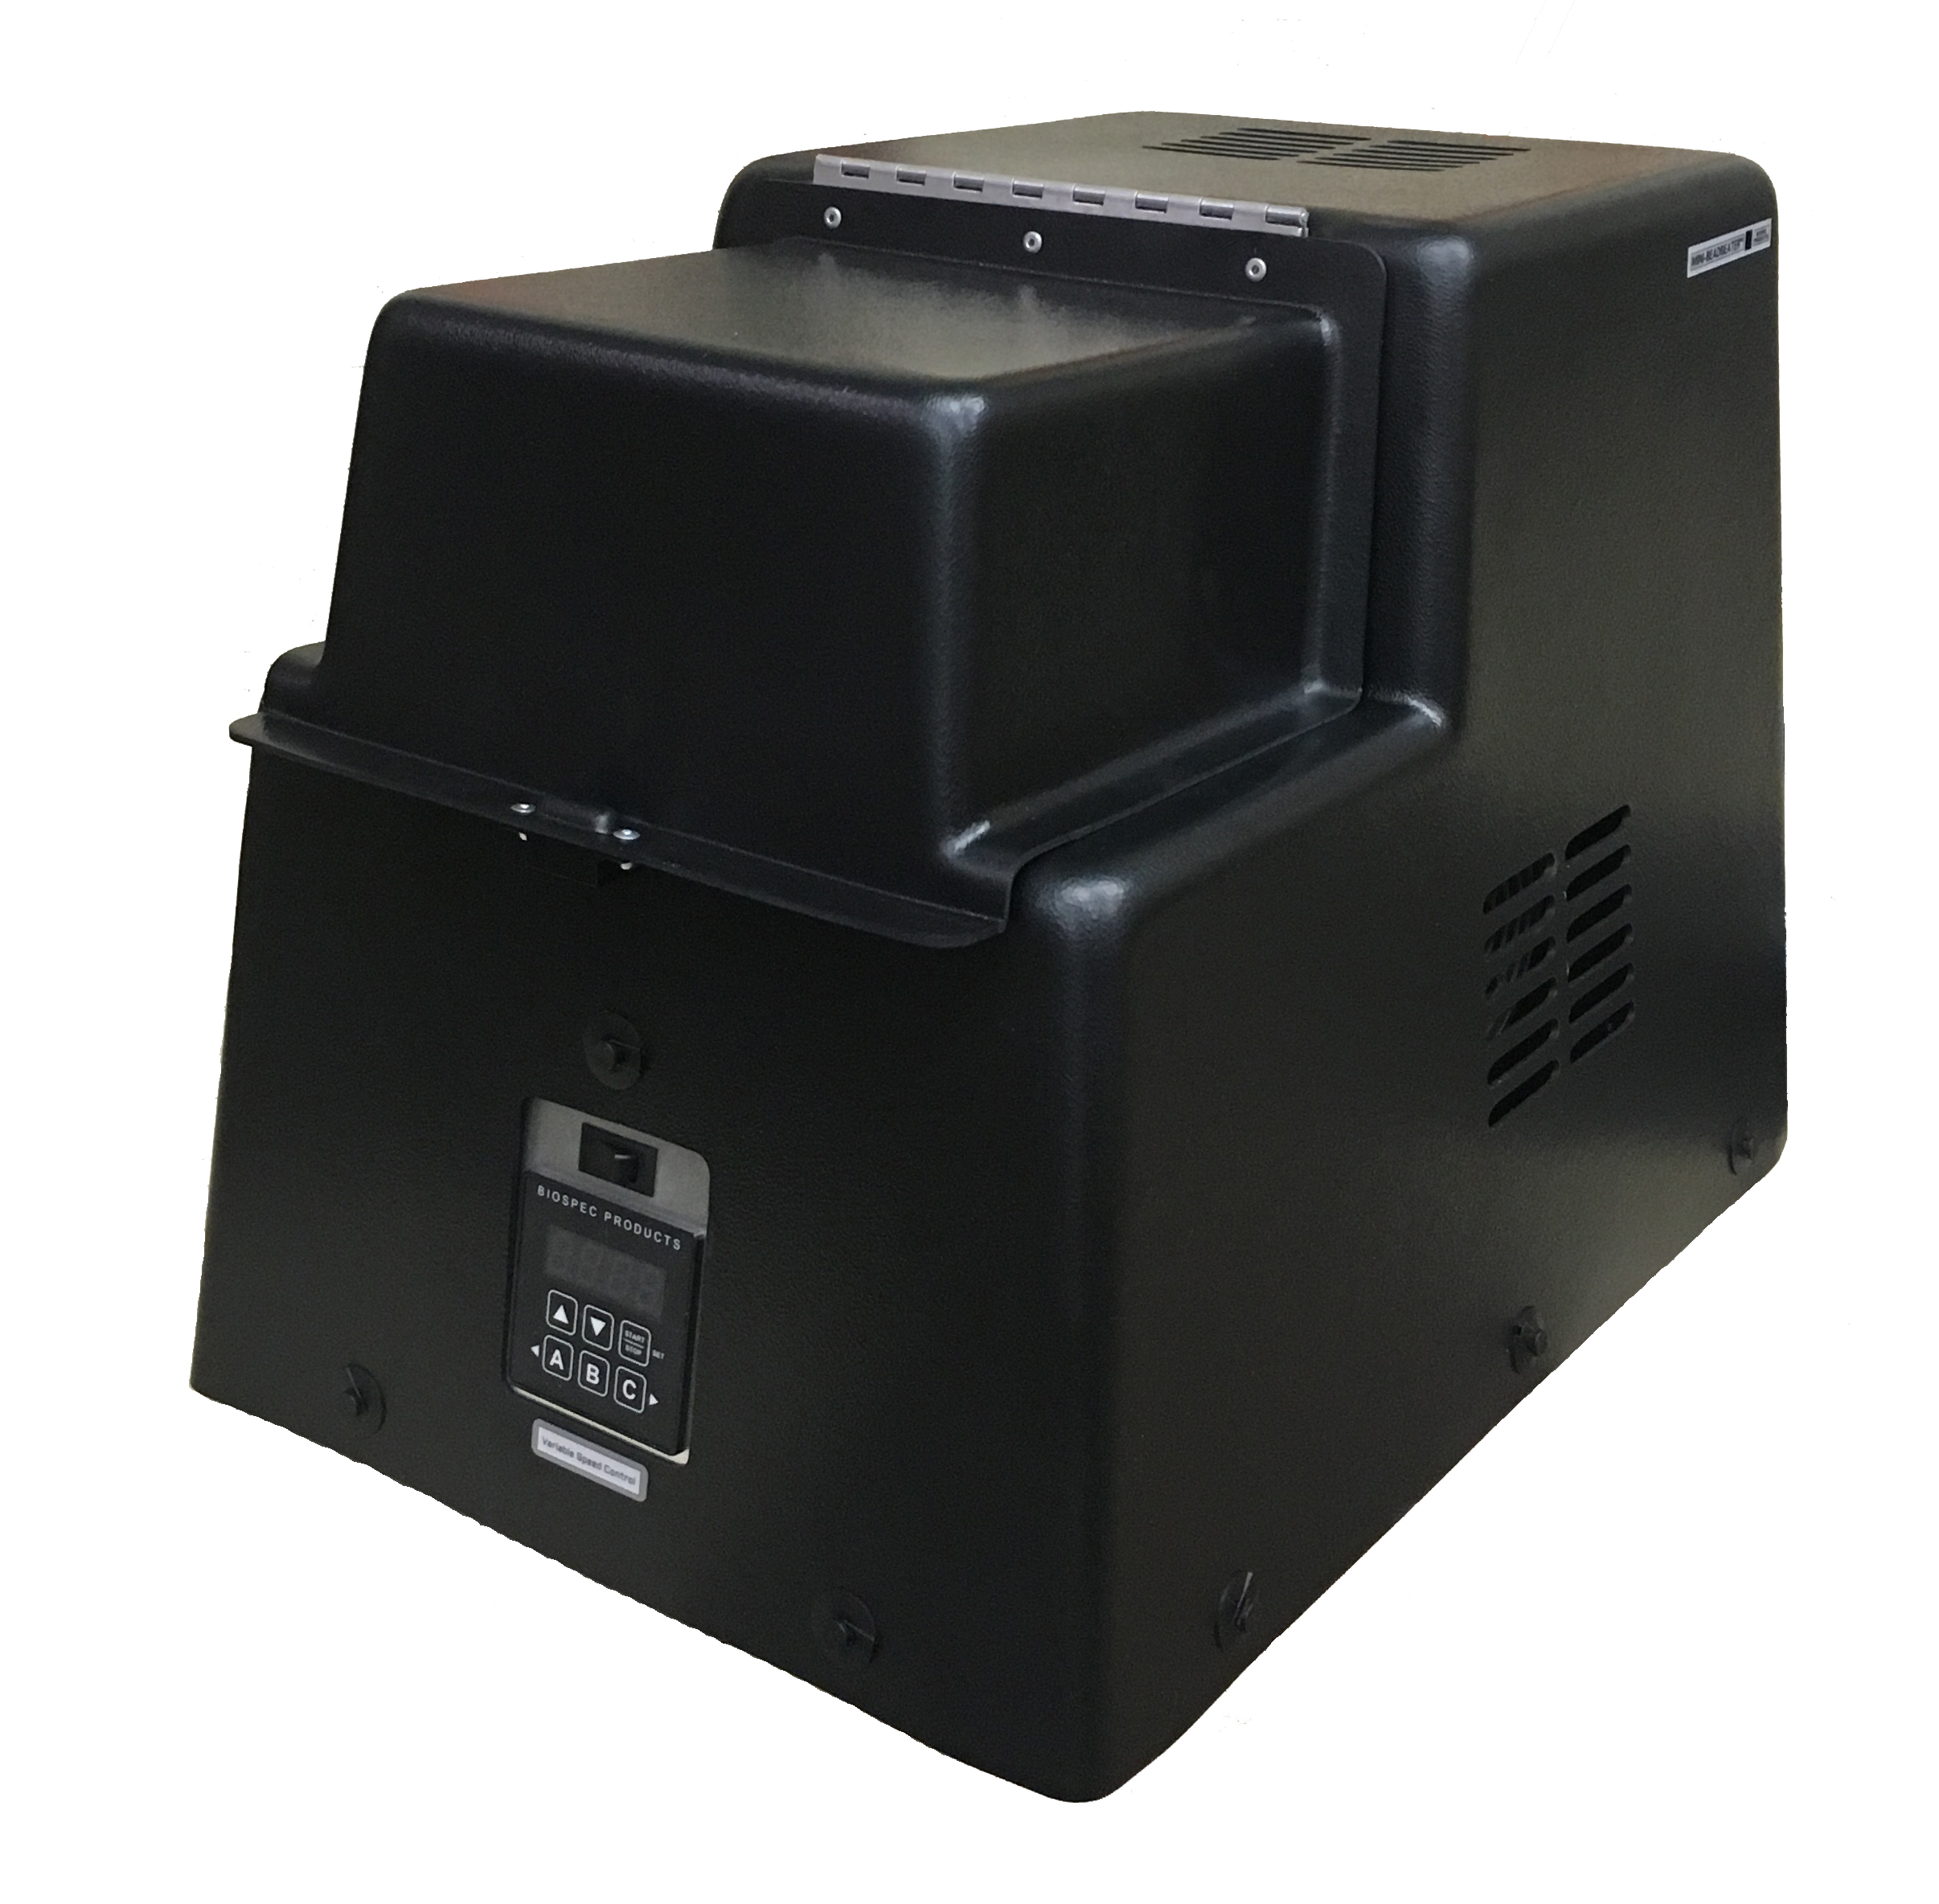
Automated extractor
LUMINEX 200
Real time PCR
Since 1959
Insect chambers
NextSeq 500
MAGPIX®
Bead beater
Digital droplet PCR
Adama (formerly Nazareth) Malaria Training Center (NMTC)

Slide 26
Acknowledgements
Graduate students
Hiwot Teka
Melat Abdo
Saron Fekadu
AHRI staff
Endashaw Esayas
Temesgen Ashine
Temesgen Tafesse
Migbaru Keffale
Lemlem Nesro
Endalamaw Gadisa
PMI/CDC/Abt Associate
Meshesha Balkew
Seth Irish
Dereje Dengela
Peter Mumba
Sarah Zohdy

