Slide 1
Using integrated data for vector control decision-making x Dr. Emmanuel Kooma 14 October 2021

Slide 2
Monitoring & optimizing vector control coverage

Slide 3
Data Use Goal & Intervention Context
Data Use Goal: To ensure vector control coverage through monitoring IRS and ITN implementation across all implementing partners at the district and health facility level
Intervention Context:
Zambia’s IRS & ITN Mass Campaign Strategy, 2020
50% of population protected by IRS
50% of population protected by LLINs
Allow for 10% overlap
Zonal (sub-health facility) level targeting of IRS and ITNs
Implementation support:
IRS:
Funded by GRZ, Global Fund, and PMI
Implemented by NMEP and VectorLink
Technical assistance from MACEPA & Akros in select districts
ITNs
Funded by GRZ, Global Fund, and PMI
Implemented by NMEP
Technical assistance from VectorLink

Slide 4
What data/indicators do you use?
IRS | Numerator [Data Source(s)] | Denominator [Data Source(s)]
IRS
Spray Coverage | Structures Sprayed [Spray Operator Forms] | Structures Found [Spray Operator Forms]
Spray Progress | Structures Sprayed [Spray Operator Forms] | Structures Targeted [National or District Microplan, GRID3 Maps]
ITNs
ITNs distributed from requested | ITNs distributed [ITN distribution forms] | ITNs requested [ITN household registration forms]
Combined
Combined IRS & ITN Population Protected | IRS: People living in structures sprayed [Spray Operator Forms] ITNs: ITNs issued *2 [ITN distribution forms] | Total population [Central Statistics Office Census Projections, District Headcount from Microplan, GRID3 Maps]

Slide 5
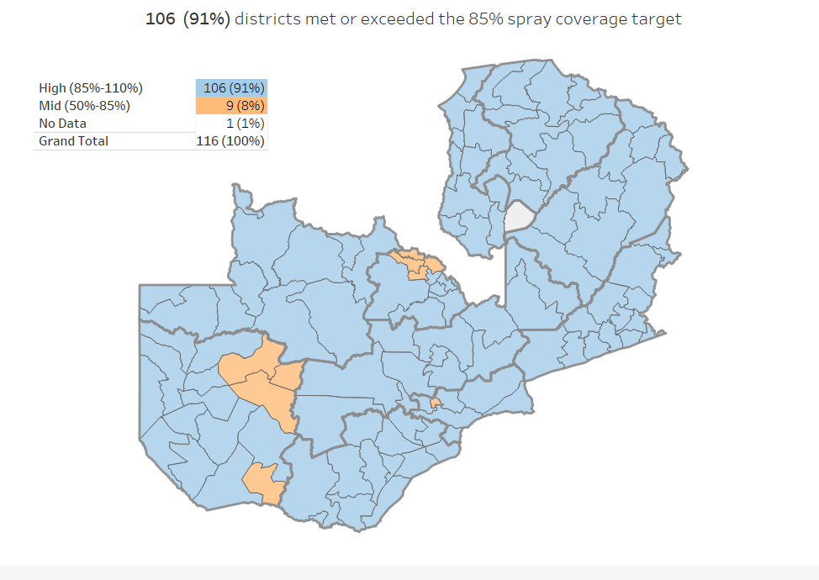
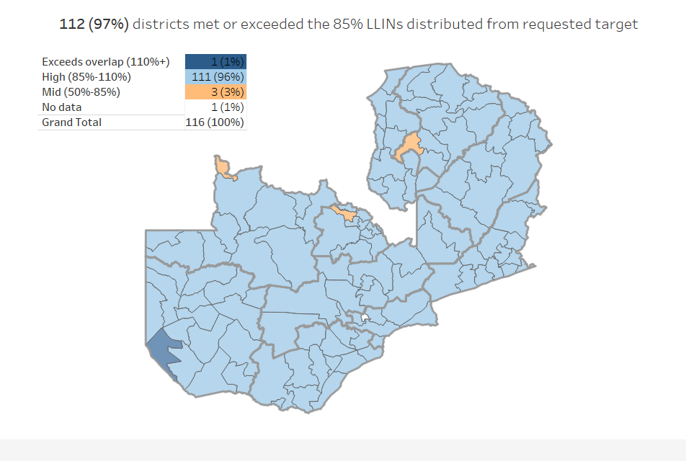
Data Use: Example 1
Able to assess all key indicators across IRS & ITN campaign (at province, district, and facility levels)
Figure 1. IRS spray coverage, by District
Figure 2. ITNs distributed from requested, by District

Slide 6
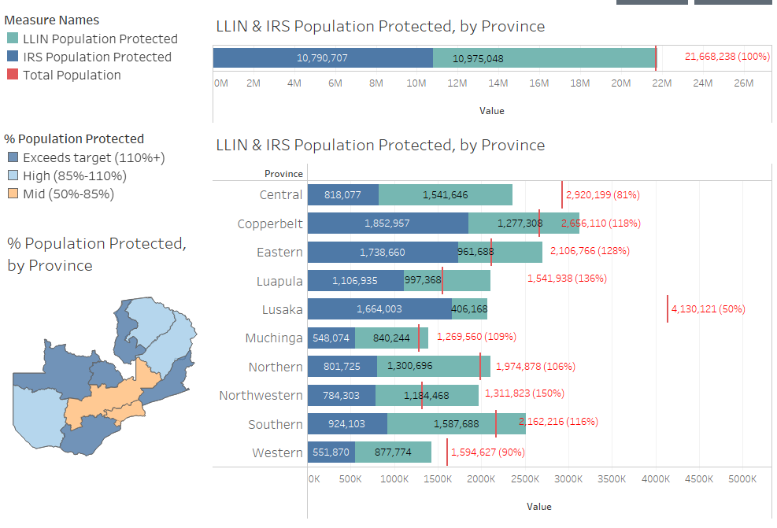
Data Use: Example 1 (con.)
Able to assess all key indicators across IRS & ITN campaign (at province, district, and facility levels)
Figure 3. Population protected at the province level
Figure 4. Population protected at the health facility level
Notes:
Data Flow

Slide 7
Recommended strategies/techniques
Using DHIS2 to collect both IRS and ITN data, allowing data integration
Using additional tools as needed to integrate other data sources, create supplemental visualizations and share data
Paper-based
Spray Operator Form
Paper-based
Supervisor Form
DHIS2 Database
NMEC DHIS2
HFCA-level
Integration, Visualization & Reporting
NMEC DHIS2
Tableau
Paper-based
Spray Operator Form
Paper-based
Supervisor Form
DHIS2 Database
VectorLink Collect DHIS2
Zone-level
Mobile Tool
Reveal

Slide 8
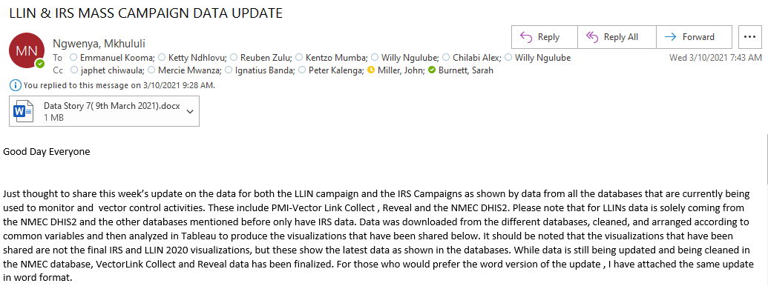
Recommended strategies/techniques
Weekly updates shared with all vector control team and partners on the progress of both IRS and ITN campaigns

Slide 9
Data use challenges
Multiple population data sources (census, headcount, geospatial) at the district level, lack of population data at the health facility level (census missing for some facilities)
Zonal level targeting
Interoperability issues
Duplicate entries in the DHIS2 due to poor internet connection
Data use to guide IRS ‘mop-up’ campaigns

Slide 10
Future plans for enhanced data use
Adding quality assurance indicators to IRS monitoring dashboards:
Data entry timeliness
Structures sprayed per day
Room coverage
Support IRS provincial commanders to interpret & use progress & quality indicators to guide supportive supervision
Automating weekly updates
Notes:
Continue to improve data use at lower levels (province & district)
Train and support IRS provincial commanders to enhance supervision for quality IRS performance and impact through data use

