Slide 1
Advancing Progress in Malaria Control: Optimizing the Collection, Analysis, and Use of Entomological Data for Vector Control Decision-Making.
Presenters: Neil Lobo, Élodie Vajda (ND, UCSF),
and Joseph Chabi (PMI VectorLink Cote d’Ivoire)
November 12, 2020

Slide 2
Our Presenters
Neil F Lobo
Notre Dame
Élodie Vaja
UCSF
Joseph Chabi
PMI VectorLink Cote d’Ivoire

Slide 3
What is the Entomological Surveillance Planning Tool (ESPT?)
A decision-support tool for planning entomological surveillance activities, interpreting entomological data, and guiding programmatic vector control decisions.
Notes:
Transition sentence could be: “The ESPT embraces and advocates for 3 key principles to enhance entomological surveillance and maximize impact of interventions.”

Slide 4
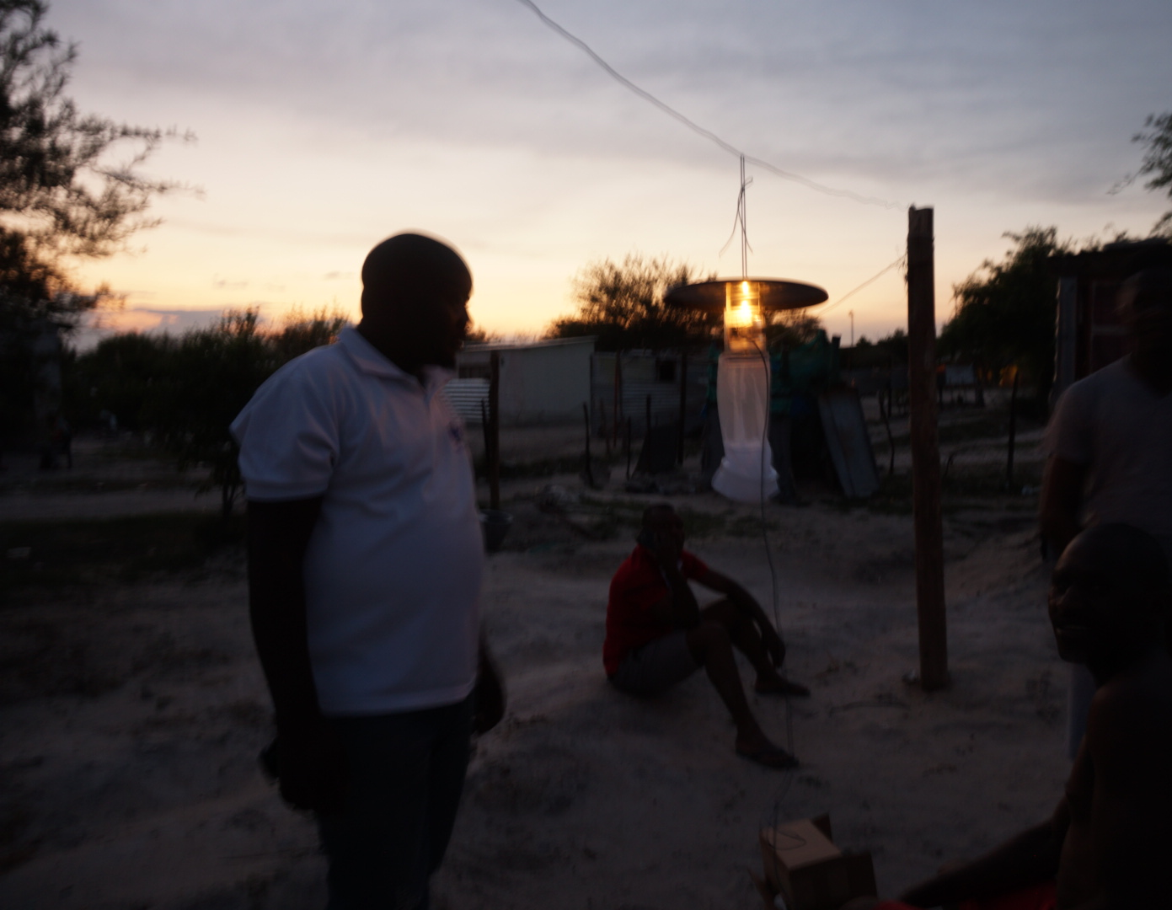
Objectives of the ESPT?

Slide 5
Objectives of the ESPT
To support gap-filling in operational guidance for entomological surveillance
To align with and operationalize WHO and PMI global normative guidance
To develop minimum essential entomological indicators to generate data that is actionable and collectable – Evidence Based Decision Making by national malaria programs
To deepen the integration of entomological, epidemiological (etc.) surveillance and response

Slide 6
Key ESPT Principles

Slide 7
Three Key ESPT Principles
Entomological surveillance should be question-based
To guide selection of minimum essential indicators while accounting for program capacity, performance and funding
Interventions function by taking advantage of mosquito behaviors
Human behaviors impact intervention efficacy.
Notes:
Examples will be given

Slide 8
Minimum Essential Indicators
Larval Control
LLINs
IRS
Vector occurrence
Receptivity
Vector Occurrence
Receptivity
Changes in
Composition
Vector density
Habitat availability
Vector Density
Habitat Availability
Changes in
Behavior
Seasonality
Habitat occupancy
Seasonality
Habitat Occupancy
Place
Place
Larval density
Biting Behaviors
Larval Density
Biting Behaviors
Time
Time
Resting Location
Emergence
Spread
Resting location
Resistance frequency
Resistance Frequency
Insecticide Resistance
Insecticide Resistance
Resistance Status / Intensity
Resistance status / intensity

Slide 9
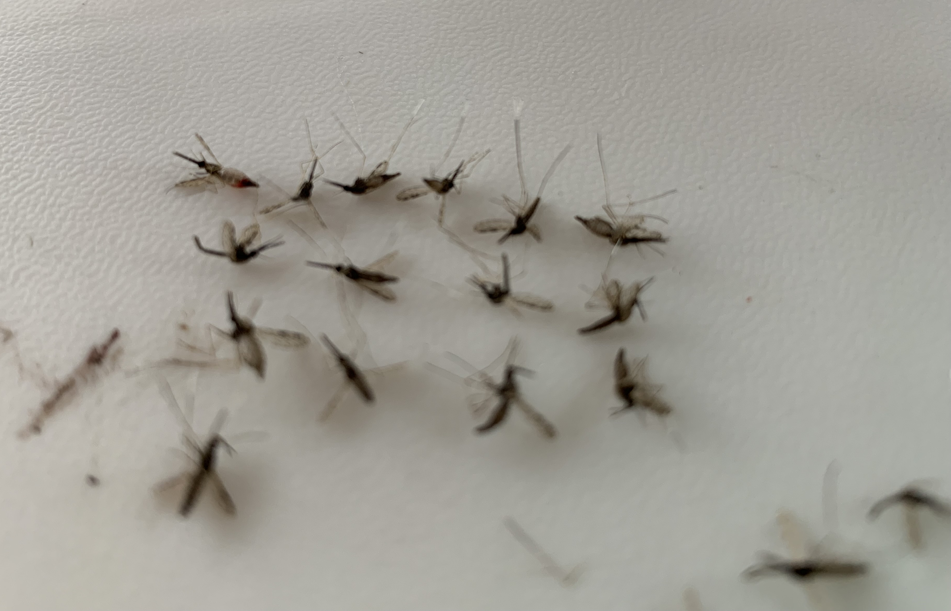
How Does the ESPT Work?

Slide 10
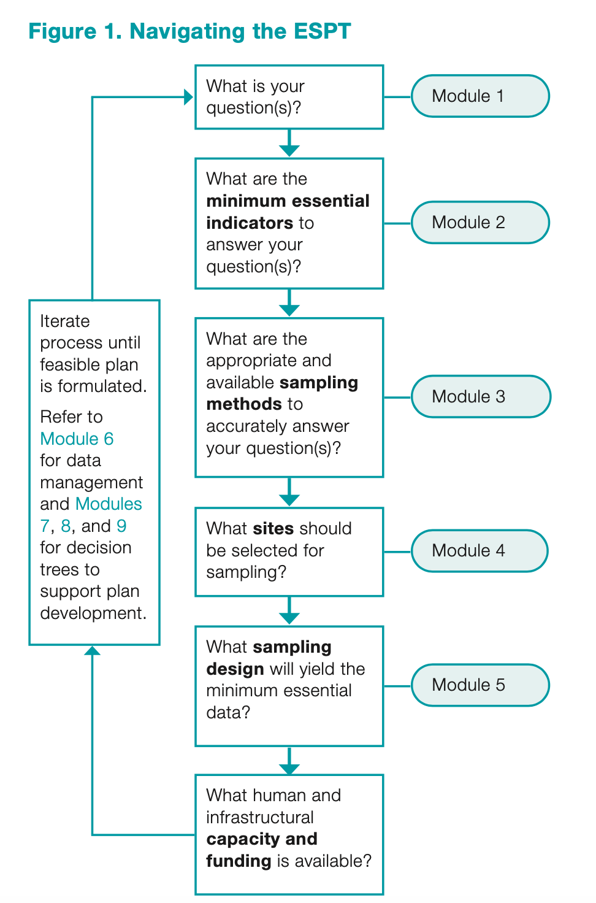
ESPT 2.0
ESPT is naturally adaptive, and you can work through the tool iteratively to address NEW programmatic questions as they emerge.

Slide 11
Examples of ESPT Application

Slide 12
Are LLINs an Effective Vector Control Tool?
The ESPT asks primary questions:
1. What are the mosquito behaviors?
2. What are the human behaviors?
3. What is the insecticide resistance status?
How LLINs function
Gaps in Protection
1
2
3
LLINs target late night, indoor biting mosquitoes
Humans have to be indoors and sleeping under LLINs to be protected at night
Mosquitoes have to be susceptible to the insecticide on the LLIN to have a community impact
LLINs are not effective on early evening or outdoor biting mosquitoes
Humans not under LLINs or outside at night are not protected by LLINs
Mosquitoes may be resistant to the insecticide used on the LLINs

Slide 13
Question
What are the mosquito behaviors?
What are the human behaviors?
Insecticide resistance status
Indicators
Vector: Human Biting Rate (HBR) inside, HBR outside, Biting Time, insecticide resistance (IR)
Human: location by time, LLIN use, time to sleep
Sampling methods
HLC + Human Behavior Observations (HBOs) inside and outside houses
Larval surveys
HLC + Human Behavior Observations (HBOs) inside and outside houses
Larval surveys
Sampling design
3 time points (based on seasonality)
2 sentinel houses per site
5 collection days per collection time point
Site selection
2 key sampling sites with 2 separate cultural practices and lifestyle habits
Capacity / funding
IR tests for LLINs not feasible (funds were used for another question on IRS)

Slide 14
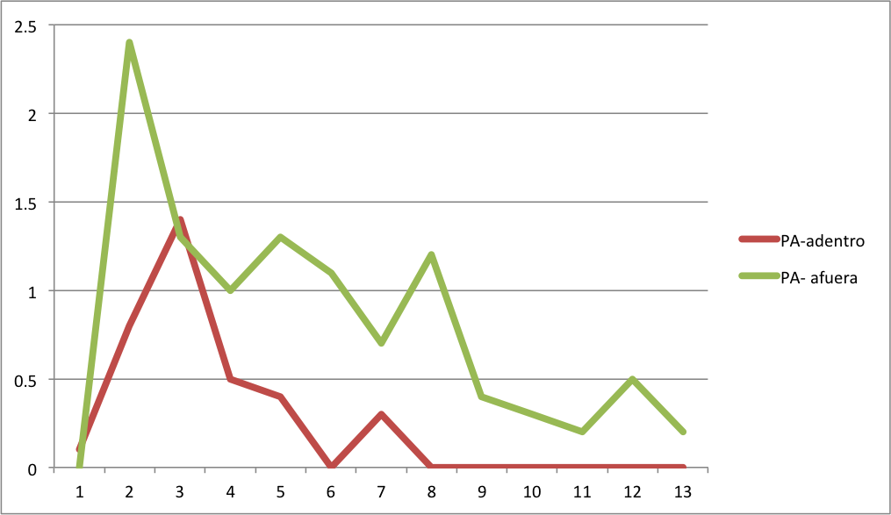
Key Findings: Vector Behaviors
Vectors are biting both indoor and outdoors
Primary biting is outdoors
Primary biting is early evening
HLC data
Anopheles landing /person/hour
IN
OUT
17h00 20h00 23h00 02h00 05h00
Hour of collection (1700-0600h)

Slide 15
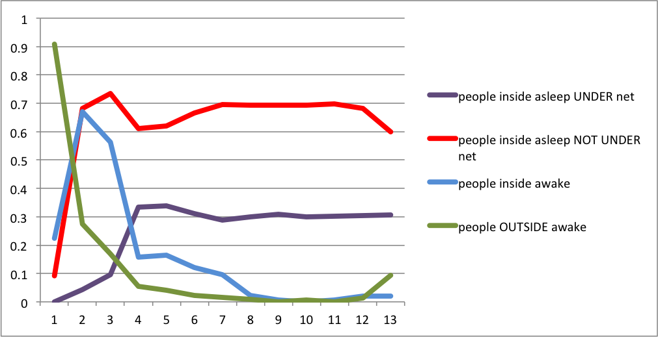
Key Findings: Human Behaviors
Human behavior (observations during HLCs)
INSIDE asleep UNDER LLINs
INSIDE asleep NOT UNDER LLINs
INSIDE awake
OUTSIDE awake
Proportion of people
17h00 20h00 23h00 02h00 05h00
Hour of collection (1700- 0600h)

Slide 16
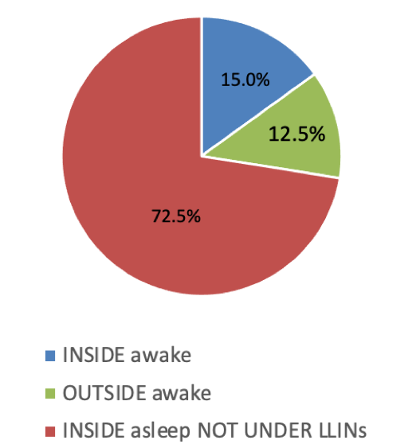
Key Findings: Human Behaviors
Human Behavior data
Time spent over the night
Notes:
15% = 216 hours
12.5% = 164 hours
72.5% = 1039 hours

Slide 17
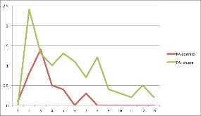
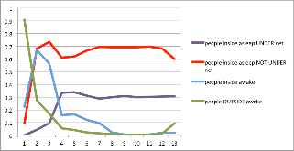
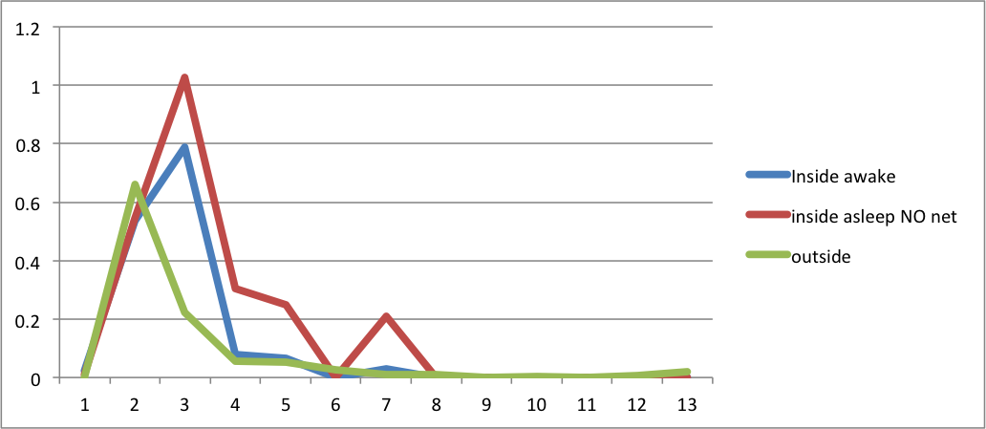
Key Findings: Human-Vector Exposure
Mosquito
Behavior
+
Human
Behavior
ADJUSTED BITING RATES (Risk of being bitten)
Most biting is outside (by HLCs), but most exposure is indoors based on human behaviors and LLIN use
Adjusted biting rates
(Anopheles/person/hour)
INSIDE awake
INSIDE asleep NOT
under LLINs
OUTSIDE awake
17h00 20h00 23h00 02h00 05h00
Hour of collection (1700- 0600h)

Slide 18
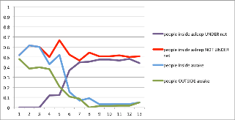
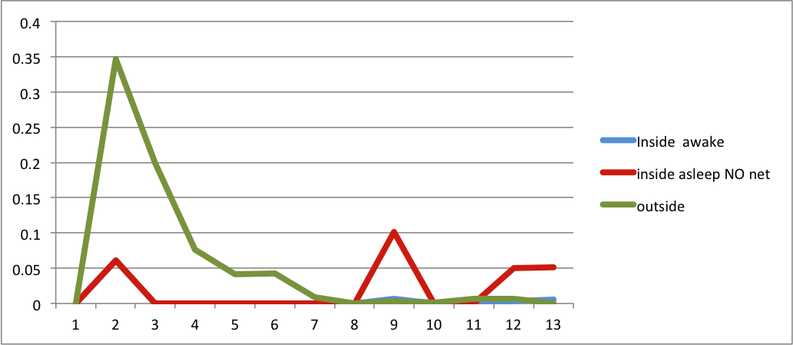
Key Findings: Human-Vector Exposure
Mosquito
Behavior
+
Human
Behavior
ADJUSTED BITING RATES (Risk of being bitten)
Another site:
Most exposure is outdoors based on human behaviors and LLIN use
INSIDE awake
INSIDE asleep NOT
under LLINs
OUTSIDE awake
Adjusted biting rates
(Anopheles/person/hour)
17h00 20h00 23h00 02h00 05h00
Hour of collection (1700- 0600h)

Slide 19
What Can We Do?
ADJUSTED BITING RATES (Risk of being bitten)
Increase LLIN use?
28.0%
29.4%
28.0%
29.4%
Topical or spatial repellants?
42.7%
42.7%
INSIDE awake
INSIDE asleep NOT
under LLINs
OUTSIDE awake
Adjusted biting rates(Anopheles/person/hour)
Larval source management, Topical or spatial repellants?
17h00 20h00 23h00 02h00 05h00
Hour of collection (1700- 0600h)

Slide 20
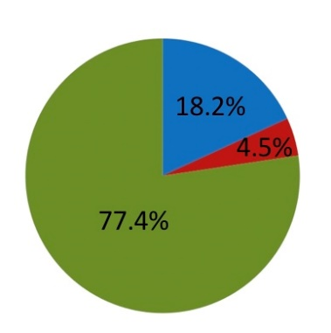
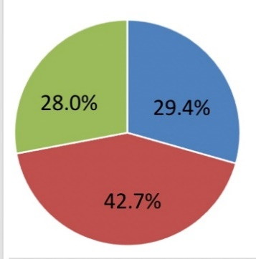
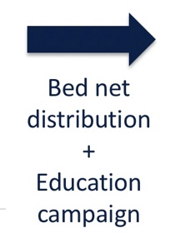
Implementation of Evidence-Based Decision
New LLIN distribution + Education campaign changed exposure
ADJUSTED BITING RATES (Risk of being bitten)
March 2019
August 2019

Slide 21
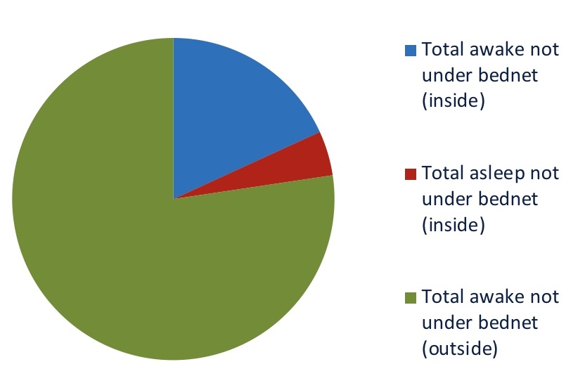
Answering the Program’s Question
Program question: Are LLINs an effective vector control tool?
Answer:
LLINs are an appropriate and effective intervention but are not sufficient as a sole intervention.
Other interventions must also be included to address the identified gaps in protection.
18.2%
4.5%
77.4%

Slide 22
IRS and Insecticide Resistance: Is IRS an Effective Intervention in My Area?
1.
2.
Are the vectors’ behaviors (resting indoors) applicable to IRS? (proportion of vectors impacted)
Are the vectors (that rest indoors) susceptible to the active ingredient?
Are the vectors resting outdoors? (gaps in protection)
Are the vectors resistant to the active ingredient? (gaps in protection)

Slide 23
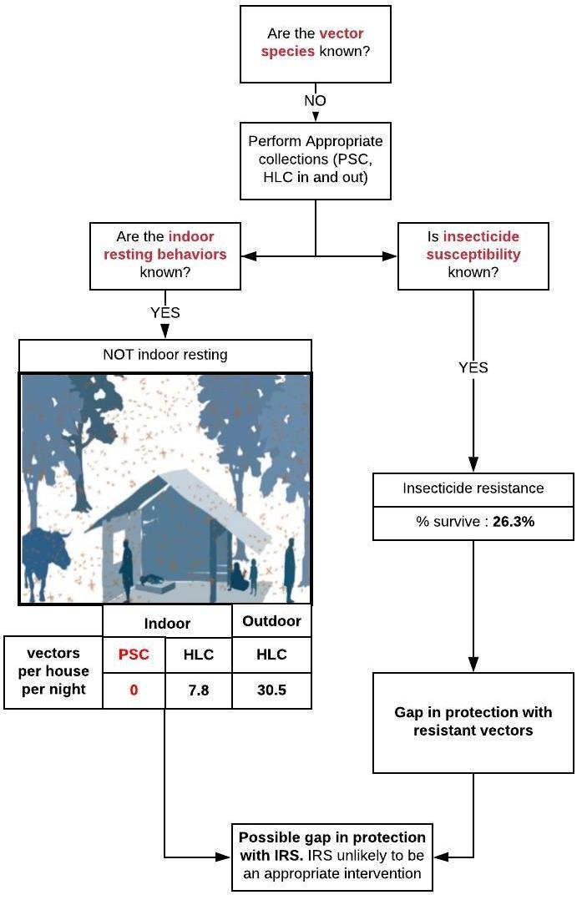
Answering the Program’s Question
Program question: Is IRS an effective intervention in my area?
Answer:
Primary vectors are not resting indoors (0 found resting indoors)
Vectors are classified as resistant (26.3%) to the IRS active ingredient
IRS probably not applicable to local vectors
Alternative interventions need to be investigated based on vector bionomics

Slide 24
Use Of Entomological Data For Vector Control Decision Making Case Example Of Cote d’Ivoire

Slide 25
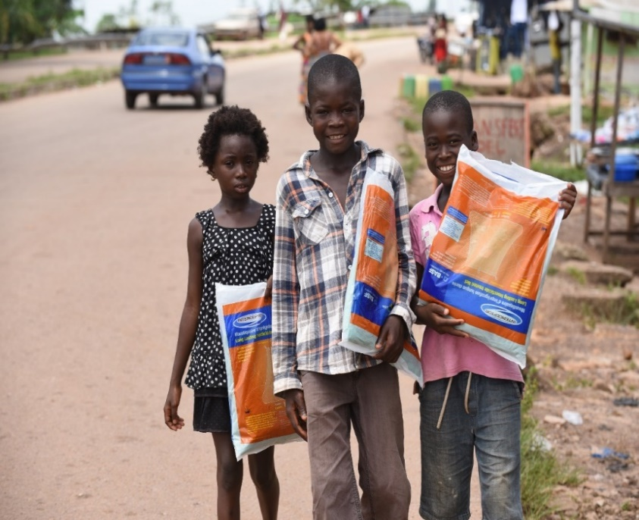
Vector Control Background in CI
Cote d’Ivoire initially based its malaria vector control on the mass and continuous distribution of LLINs across the country
The country has had 2 mass campaigns conducted in 2014 and 2017 using pyrethroid-only treated LLINs
Procurement of LLINs distributed were done without any consideration of entomological data to support the type of LLINs to be purchased
The Global Fund represented the only donor of the country and has supported procurement and distribution of LLINs
No history of IRS in the country before 2020 when 2 districts were selected to receive IRS based on their high malaria incidence

Slide 26
PMI VectorLink Approach and Change in Vector Control Procedures
The country received PMI funds in 2018 with the aim of implementing IRS as the main vector control measure in the country
Additional support was provided for quality data collection that included entomological and epidemiological data
Entomological data on vector behavior, density, infectivity and insecticide resistance were considered as a basis for all decisions on vector control
The PMI VectorLink Project managed and conducted the vector control aspect within the scope of activities related to the PMI funds allocated to the country

Slide 27
Entomology Data Collection per ESPT Monitoring Methods
Question
What are the vector species?
What are the vector behaviors?
What is the seasonality of vectors?
Insecticide resistance status
Vector: Human Biting Rate (HBR) inside, HBR outside, Biting Time, indoor resting density, seasonality, Entomological inoculation rate (EIR), insecticide resistance (IR),
Infection data: Cases over time (incidence)
Indicators
Sampling methods
HLC, PSC (indoor resting collections) larval collections (for IR tests), IR: WHO Bioassays and CDC Bottle assays
Health Facility malaria case data
Sampling design
monthly time points (12 per year)
4 sentinel houses per site
2 collection days per collection time point
Site selection
15 sentinel sites across country (7 insecticides tested for susceptibility, intensity and synergist assays)
Capacity / funding
Funds/capacity available for the above strategy (4 research institutes involved in data collection locally)

Slide 28
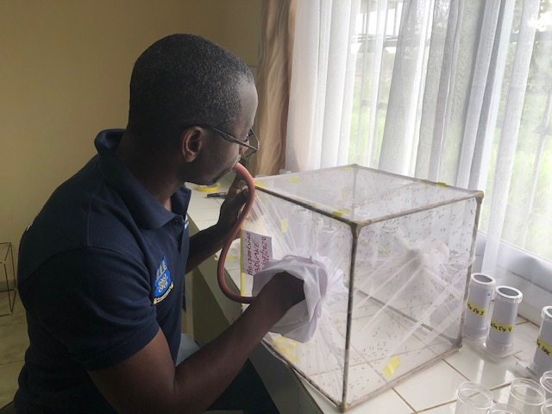
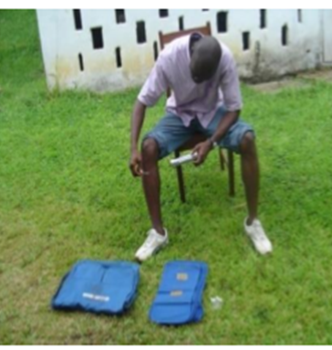
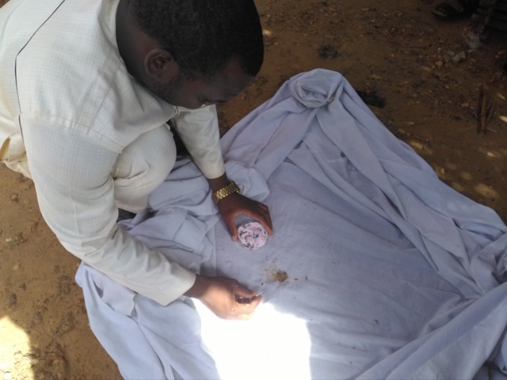
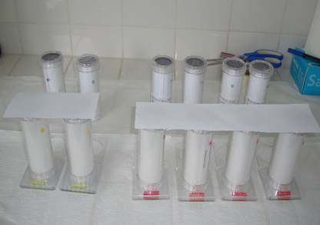
Entomology Data Collection Methods
Insecticide Resistance Monitoring
Vector Bionomics
HLC
CDC LT
PSC
CDC Bottle Assays
WHO Tube Assays

Slide 29
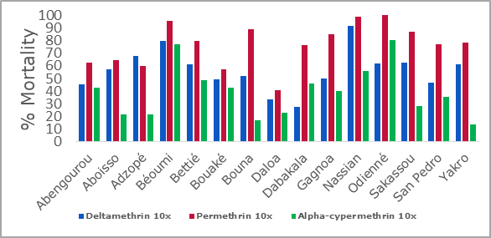
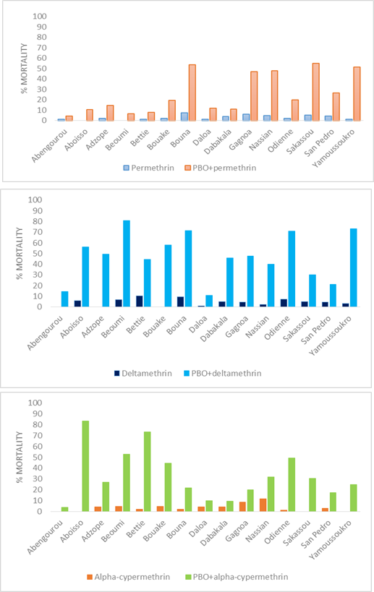
Pyrethroid Resistance
Pyrethroid resistance was observed
in all 15 sites monitored
5x and 10x the DC
High pyrethroid resistance
PBO + Pyrethroids
Significant increase of mortality
Resistance Status with pyrethroid insecticides used for bed net impregnation
98% threshold for susceptibility
90% threshold for susceptibility
8

Slide 30
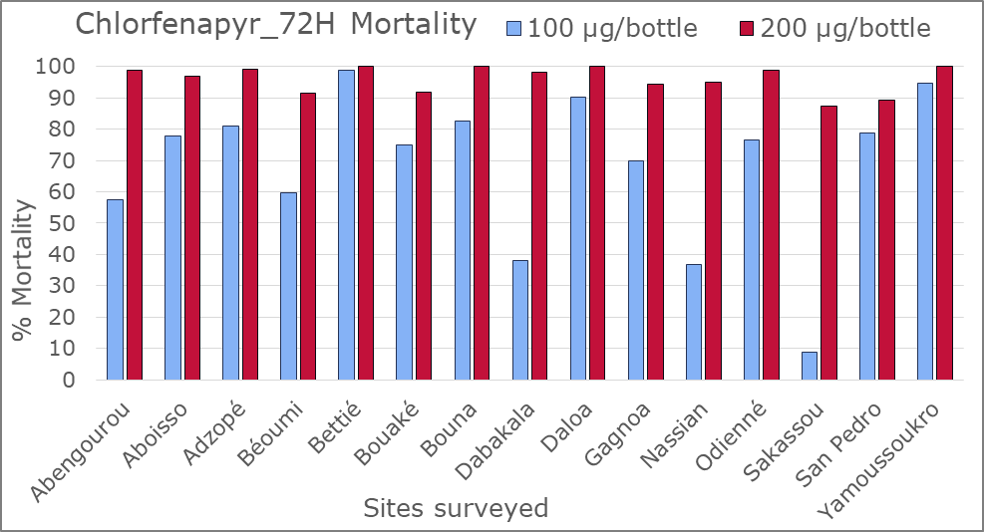
Chlorfenapyr Susceptibility Status

Slide 31
LLIN Decision Making
Data on vector insecticide susceptibility was used to stratify the ongoing 2020 LLIN mass distribution
PBO-LLINs were introduced in LLIN distribution for the 2020-2021 mass campaign based on the results of the IRM showing significant increment of mortality using PBO
Interceptor G2-Nets were also introduced in LLIN distribution for the 2020-2021 mass campaign based on the susceptibility observed using chlorfenapyr in the selected sites and extrapolated to the districts
Furthermore, PMI is procuring 2,815,000 PBO nets to be distributed with PMI support and in coordination with NMCP for the ongoing LLIN mass distribution campaign.

Slide 32
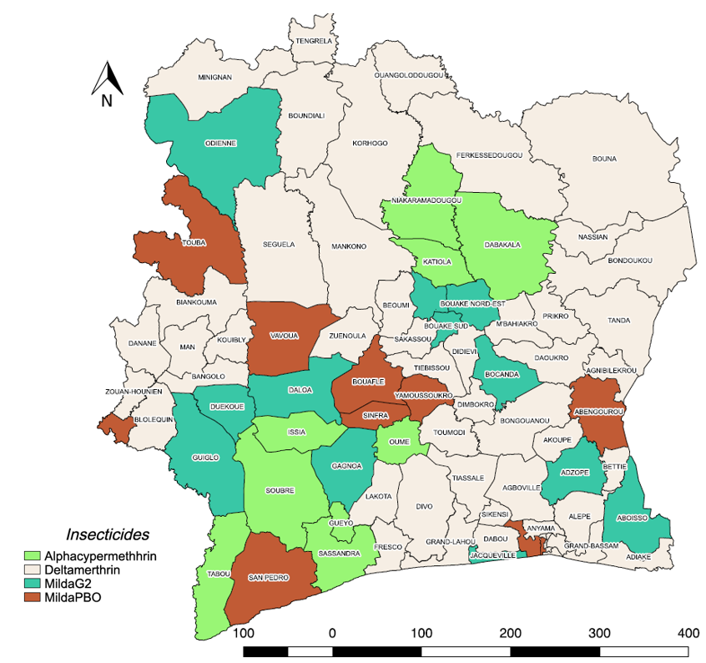
LLIN Distribution Stratification Map

Slide 33
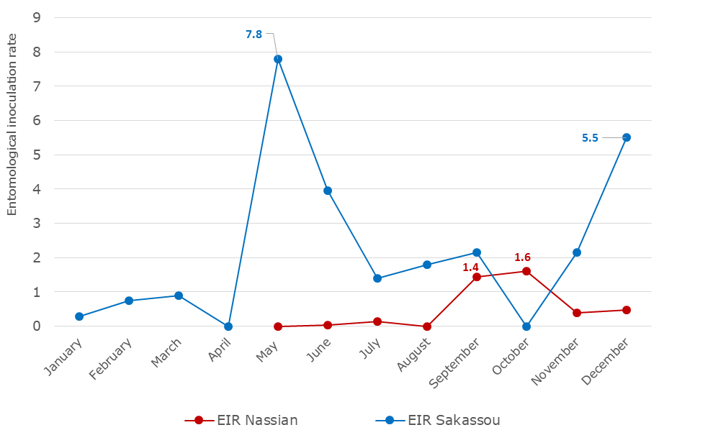
Susceptibility to IRS Insecticides and Entomological Inoculation Rate (EIR)
Susceptibility to clothianidin 2% in both Nassian and Sakassou
Susceptibility to pirimiphos methyl in Nassian and resistance observed in Sakassou
The peak of malaria transmission (EIR) was observed in May for Sakassou 7.8 infected bites per person per night (ib/p/n) and a second one observed in December (5.5 ib/p/n)
In Nassian the highest entomological inoculation rates were in September and October (1.4 and 1.6 ib/p/n, respectively)

Slide 34
IRS Decision Making
Data on vector behavior and malaria transmission and insecticide susceptibility was used for timing the first ever largescale IRS campaign in the country with the appropriate insecticides.
Following the results of the longitudinal monitoring, IRS timing was decided as:
IRS campaign in Sakassou to be started in April
IRS campaign in Nassian to be started in July
The results of the IRS insecticide tests enabled to spray clothianidin based insecticides
Fludora Fusion in Sakassou
Sumishield in Nassian

Slide 35
Way Forward
LLIN durability monitoring for programmatic decisions and evidence-based for vector management strategies
Assessment of the Entomological and Epidemiological impact after introduction of new generation LLINs in the districts receiving PBO LLINs compared to the pyrethroids-only districts
Assessment of the Entomological and Epidemiological impact of IRS in both sprayed districts
Evaluation of the residual life of each insecticide for further decision making

Slide 36
Summary
ESPT:
A decision-support tool for planning entomological surveillance activities around program objectives.
Supports entomological surveillance that is adaptive, iterative, and helps programs prioritize activities based on program capacity and priorities.
In a pilot setting: ESPT pilot enabled the program
Example 1: identify key gaps in protection and understand the impact of LLINs.
Example 2: determine that IRS is not applicable to the site’s local vectors, and thus, that other interventions must be investigated.
In an implementation setting:
Application of ESPT logic yielded data necessary to guide decision-making on:
PBO LLIN procurement,
IRS insecticide selection and timing of campaign.

Slide 37
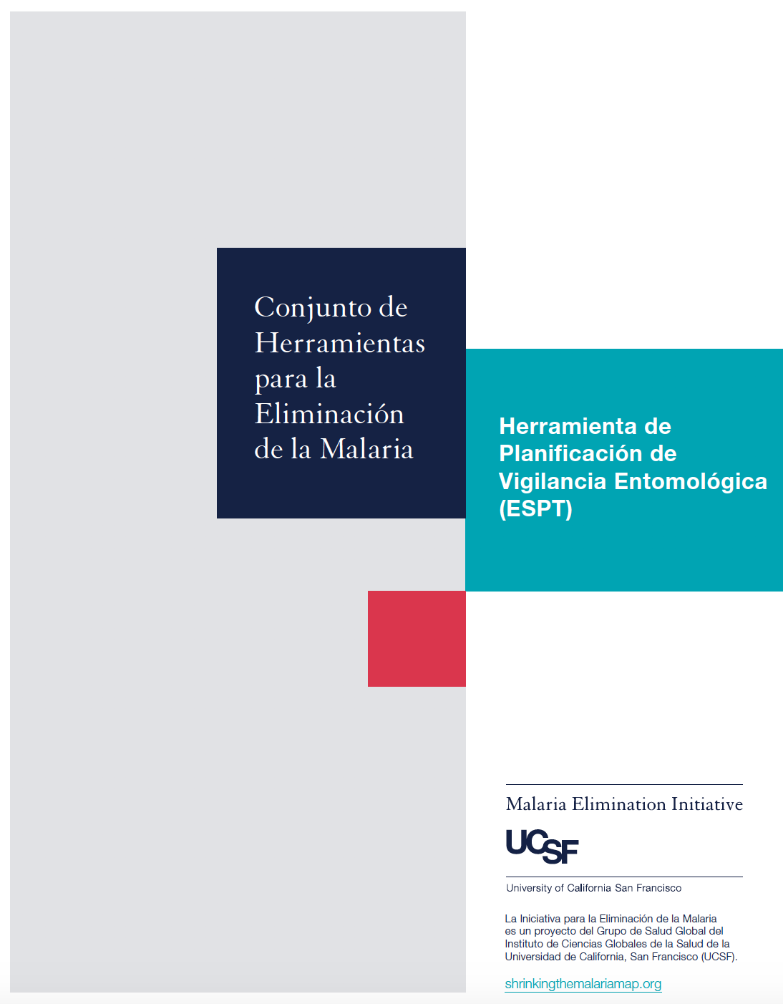
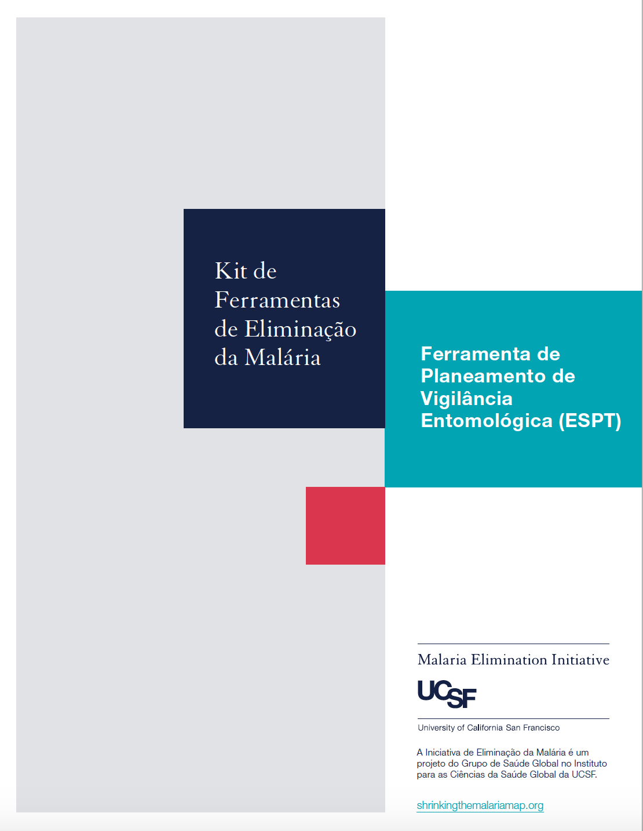
French, Portuguese, and Spanish translations by the end of 2020.
ESPT Training Materials by the early 2021.

Slide 38
Partnerships

Slide 39
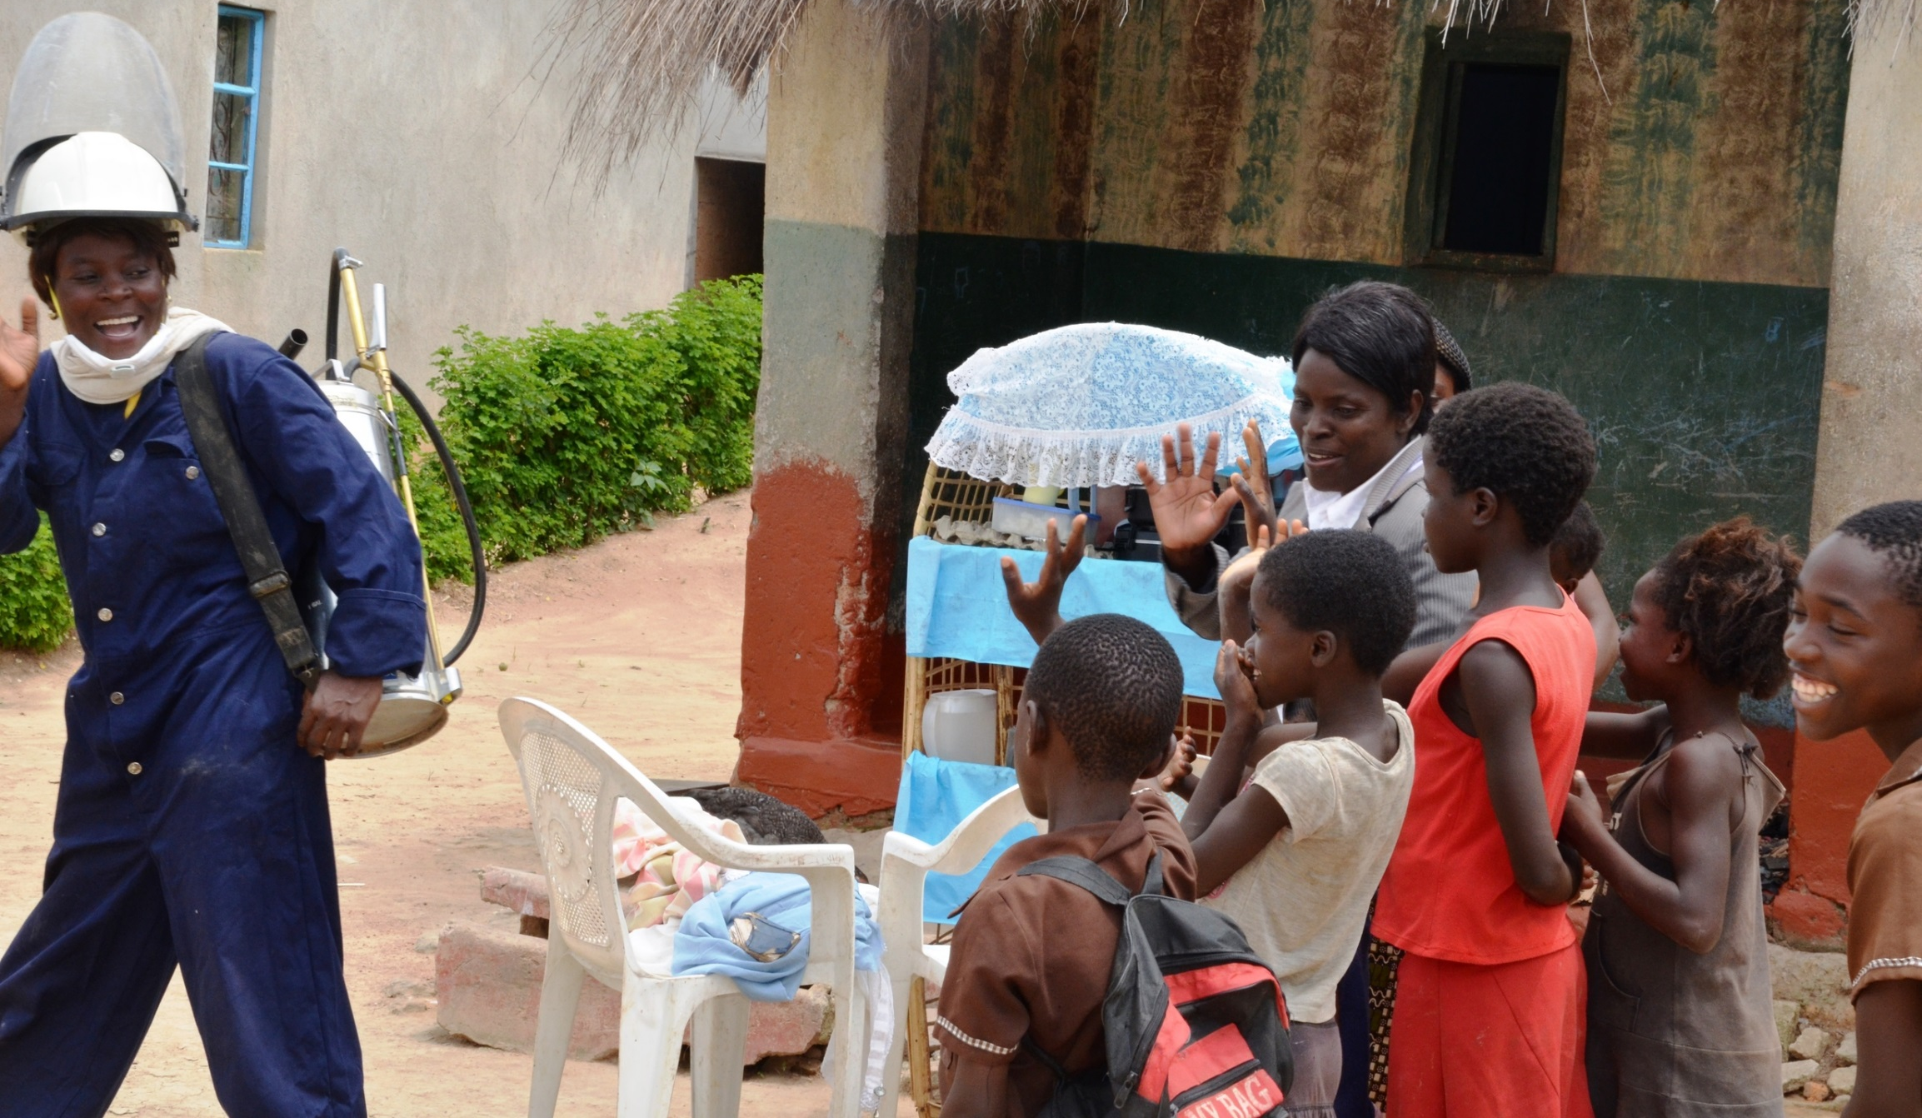
Thank You!

