Slide 1
Capacity Building on Entomological Monitoring – The Impact of Regional Trainings
Dereje Dengela, et al.
7th MIM Conference
April 16th , 2018

Slide 2
Introduction
Unprecedented progress has been achieved in the control of malaria over the past 15 years
Global: 1.2 billion fewer cases & 6.2 million fewer malaria deaths
Africa: Interventions averted 663 million malaria cases, 79% attributed to ITNs and IRS

Slide 3
Challenges…..
The advances are under threat due to:
Growing vector resistance to existing insecticides
Behavioral modification of malaria vectors in response to vector control¹.
Predominantly feeding outdoors or
Feeding early in the evening or
Feeding late in the morning
Notes:
Decreasing endophagy rates for A. funestus over the time series

Slide 4
Challenges…. Continued
Shift in species composition of An. gambiae s.l. following increase in LLIN ownership².
This behavioral change may result from :
Phenotypic plasticity or
Selection of genetically inherited traits
Notes:
--shift in vector dominance from the highly endophilic A. gambiae s.s. to the more exophilic A. arabiensis

Slide 5
The importance of entomological monitoring
Vector control may drive different adaptive responses in mosquitoes
The emergence and wide spread of insecticide resistance needs close monitoring
Next generation LLIN and IRS products will most likely cost more than products that have been in use
Deployments of these future vector control products may not be business as usual/need to be supported by entomological and epidemiological data
Notes:
-Data available highlight the importance of monitoring for these behavioral changes in a range of settings

Slide 6
Factors limiting expansion of entomological monitoring
PMI AIRS project conducted capacity assessment surveys across PMI AIRS countries in 2013.
Study outcome indicated :
Limited trained human resources
Lack of infrastructure in some countries (insectary and laboratory)
Shortages of funding to conduct entomological monitoring work.

Slide 7
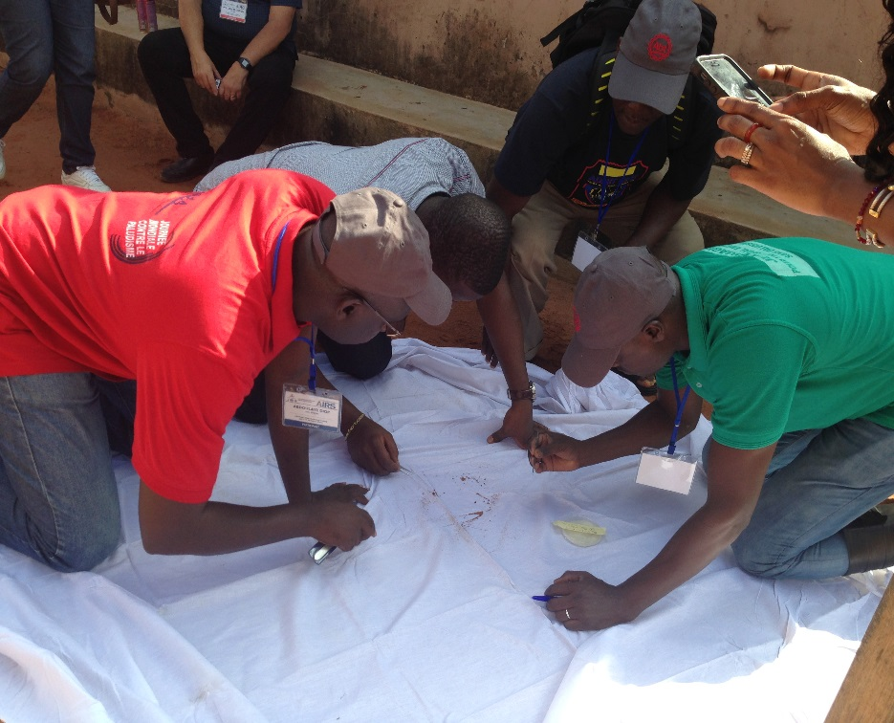
PMI AIRS project effort to improve entomological monitoring capacity
Comprehensive hands on entomology training provided in four rounds.
2015 – trained 36 people (19 gov. and 17 project staff ) from 17 countries in two rounds
2016 - trained 42 people (28 gov. and 14 project staff ) from 19 countries in two rounds
Entomology laboratory training
2017- trained 34 people (all from government) from 19 countries in two rounds
Site visits to ensure skills gained at the training are practiced & help troubleshoot

Slide 8
Main topics covered in the comprehensive entomological monitoring trainings
Role of entomology in Vector Control
Sampling malaria vectors
Morphological Identification
Ovary dissection and determination of parity rates
Insecticide resistance (WHO tube test and CDC bottle bioassays)
Insecticide resistance intensity and synergist bioassays
WHO cone bioassay
Analysis and interpretation of entomological data
Reporting entomological data

Slide 9
Main topics covered during laboratory trainings
PCR An. gambiae complex species ID
PCR M/S ( An. gambiae/ coluzzii)
PCR An. funestus
PCR blood meal
PCR Plasmodium detection
Kdr West and East
ELISA blood meal
ELISA sporozoite detection
Bio-chemical analysis
Notes:
This training was conducted in collaboration with Notre Dame University and Centre de Recherche Entomologique de Cotonou ( CREC)

Slide 10
Training methodology
Presentations
Demonstrations
Practical sessions (class room, laboratory, insectary and field)

Slide 11
Impact of the training
Expansion of insecticide resistance monitoring sites in almost all PMI countries.
In some countries entomologists who participated in the regional training championed this expansion.
Example: National Arbovirus and Vectors Research Centre monitored Insecticide Resistance in the whole of the South East of Nigeria.
Several countries organized and conducted cascade training following regional entomology training (Liberia, Nigeria, Madagascar, Rwanda, Ethiopia)
Knowledge and skill gained at the regional training helped conduct quality cascade training.

Slide 12
Impact of the training
Mobilized resources from Global Fund and established entomological monitoring sentinel sites. (Madagascar)
In countries where entomological monitoring sentinel sites already existed, training helped standardized data collection tools that contribute to quality of data collected. (Rwanda, Nigeria)
In countries where NMCP fell short of funding for entomological monitoring, the training participants are actively involved in PMI VectorLink project entomological monitoring work, supporting the project and further building their skills.
Improved insectary management. (Liberia, Madagascar)
Helped countries collect data on insecticide resistance intensity and conduct synergist assays.
Some of the trainees were from in-country Universities, upon their return they are training many students at their institutions and other neighboring institutions. (Nigeria, Ethiopia)

Slide 13
Impact of the training
Established molecular facility. (Rwanda, Ethiopia)
Quality of molecular species ID improved. (Mali)
Working to establish an additional functional molecular lab. (Madagascar, Nigeria)
Some laboratories started to use PCR for blood meal and sporozoite detection in addition to ELISA.
Started using updated protocols for kdr and species ID.
Trained others in the lab on new techniques they learned during the training, which are more sensitive and reliable. (Msc and Bsc students being trained)

Slide 14
Thank you!

