Slide 1
Increasing the use of data in IRS decision making
Megan Littrell
PMI VectorLink Project

Slide 2
Data use for IRS decision making
IRS Planning
Disease surveillance
Entomological
Climatological
Coverage
Intervention Cost
Nat’l & Global Guidance
Notes:
The PMI VectorLink project aims to ensure that IRS planning is informed by relevant data. As shown on this slide, this includes national malaria disease surveillance data, entomological data, intervention coverage data, and climatological data.

Slide 3
Key questions for national-level planning
Where do vector control intervention coverage gaps persist?
Are there geographic areas of persistently high malaria burden, despite high vector control coverage?
What is the level of insecticide resistance by geographic site?
Where should next generation LLINs and insecticides for IRS be deployed?
What is the epidemiological impact of vector control interventions, including LLINs and IRS?
IRS Planning
Notes:
When it comes to IRS planning and more broadly, planning for national vector control programs, these are some of the key questions that decision makers may be trying to answer. Where do gaps in intervention coverage persist? Are there areas of the country with persistently high malaria burden, despite high intervention coverage? What levels of insecticide resistance are present in country? Where should next generation LLINs and insecticides be deployed? What is the impact of current interventions?

Slide 4
Barriers to data use
IRS Planning
Data are often not easily accessible and readily available to decision makers, including:
Trend data from the HMIS
Entomological data
Vector control coverage data
Climatological data
Reports may not summarize data to the granular levels optimal for planning, stratification, and targeting (i.e. the district or sub-district/health facility catchment level)
Data are often not easily digestible and actionable
Notes:
Data to answer these types of questions during national planning activities may not be used for a variety of reasons. These may include: situations where data are not easily accessible and readily available to decision makers, including trend data from the national HMIS, ento data, coverage data, and climatological data. Reports may not summarize data to the granular levels optimal for planning, stratification, and targeting, such as the district or health facility catchment level. Finally, reports may not be easily digestible and actionable, with key data points and relevant action points buried within large reports full of text and figures.

Slide 5
PMI VectorLink Vision of Success
National-level planning
Disease surveillance
Entomological
Climatological
Coverage
Intervention Cost
Nat’l & Global Guidance
Analysis that is:
Timely
Digestible
Action-oriented
Notes:
For the PMI VectorLink project, we aim to address these barriers and support national level planning informed by existing data. We are providing an aggregation of data with analysis that is timely, digestible, and action oriented.

Slide 6
PMI VectorLink support
Stakeholder engagement to identify key questions and existing datasets
Access, prepare, and analyze datasets
Develop and revise visualizations
Use final visualizations to facilitate data review meetings for decision-making
Build capacity in data review and visualization
Notes:
The support that we are providing to national programs and their partners begins with stakeholder engagement to identify key questions and existing datasets. We view stakeholder engagement as key to ensuring that we develop data dashboards that will meet stakeholder information needs.
As we have a sense of stakeholder information needs, we then access, prepare, and analyze all relevant datasets and then develop and revise visualizations. We are using a program called Tableau for this work. Tableau is a powerful data visualization tool that allows for interactive data exploration.
When data dashboards are completed, we will facilitate data review meetings to support vector control decision making. Finally we are able to provide capacity building for data review and visualization.

Slide 7
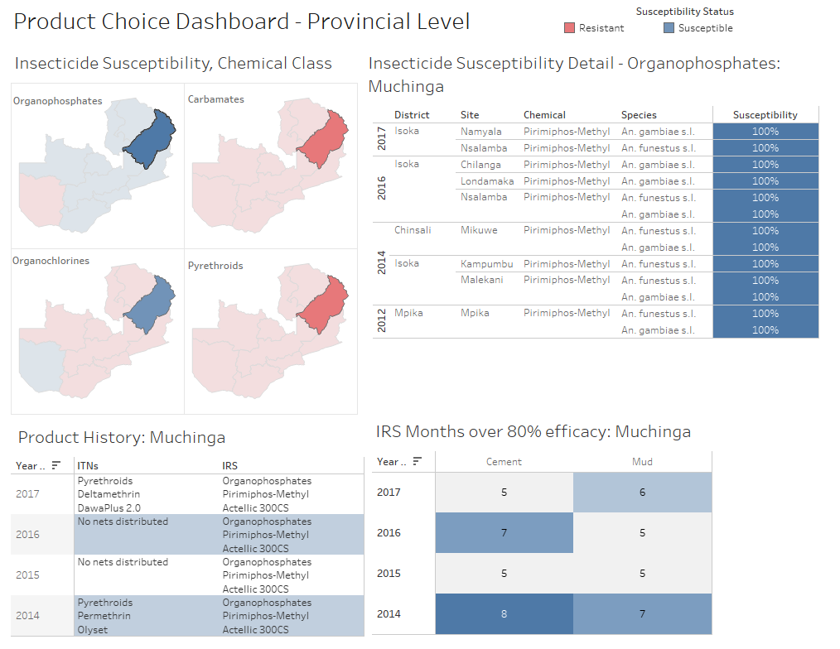
Insecticide choice and rotation for IRS
Notes:
The next few slides show a few examples of the data dashboards.
One of the dashboards we created with data from Zambia is a set of visualizations that summarize data to inform product choice and rotation for IRS.
The dashboard is interactive allowing to select provinces and review data from 2014-2017. In this snapshot, Muchinga province is highlighted and we can see which products have been used including IRS chemicals and LLINs distributed. We can also see the insecticide resistance monitoring data summarized – map view showing chemical classes and red for resistant or blue for susceptible. Then a detailed table view showing the sites for testing, the chemical tested, species, and % susceptible.
Finally here we summarize the length of efficacy for the selected chemical by year on cement and mud walls.
This summary information is intended to support decisions around which chemicals to use for IRS across geographic locations. Having all of this information easily at hand may become increasingly important and useful with an increasing number of options for insecticides and as countries implement insecticide rotation.

Slide 8
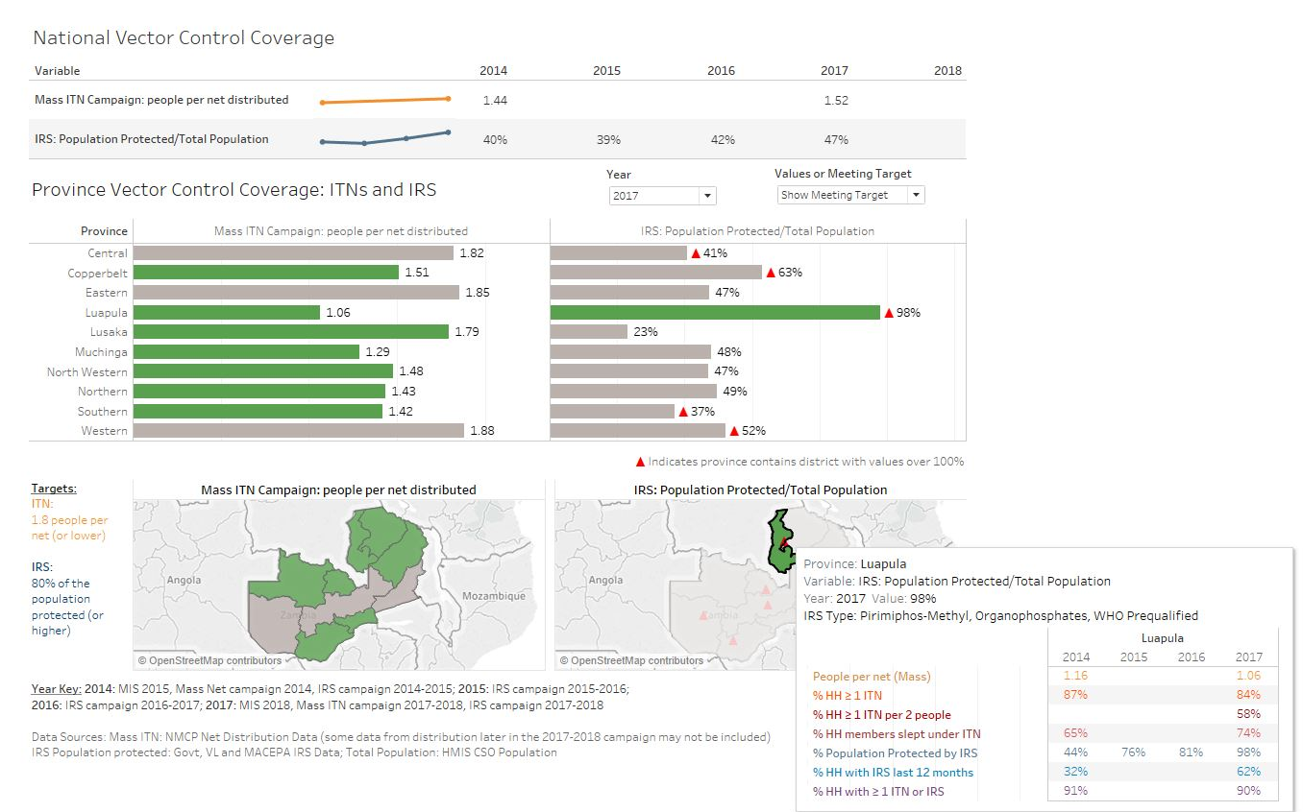
Improving vector control coverage (IRS & LLIN)
Notes:
This dashboard is summarizing vector control coverage data against targets. We include the main VC interventions here – LLINs and IRS. The main indicators we are showing here are campaign coverage – number of people per LLIN distributed during a mass campaign – against the target of 1.8 people or fewer per LLIN. And IRS population protected with the target of 80% of population protected or higher.
At the top is a national snapshot over time. Then you can explore the data down to provincial level with this view and select a given year.
One of the available summary views uses color coding to highlight whether or not targets have been met. So we can see in green the provinces that have met the LLIN campaign coverage target, and provinces that have met the IRS population coverage target.
This dashboard is designed to review coverage in relation to targets to highlight coverage gaps, and brings together the LLIN distribution and IRS campaign data for a complete view of VC coverage.

Slide 9
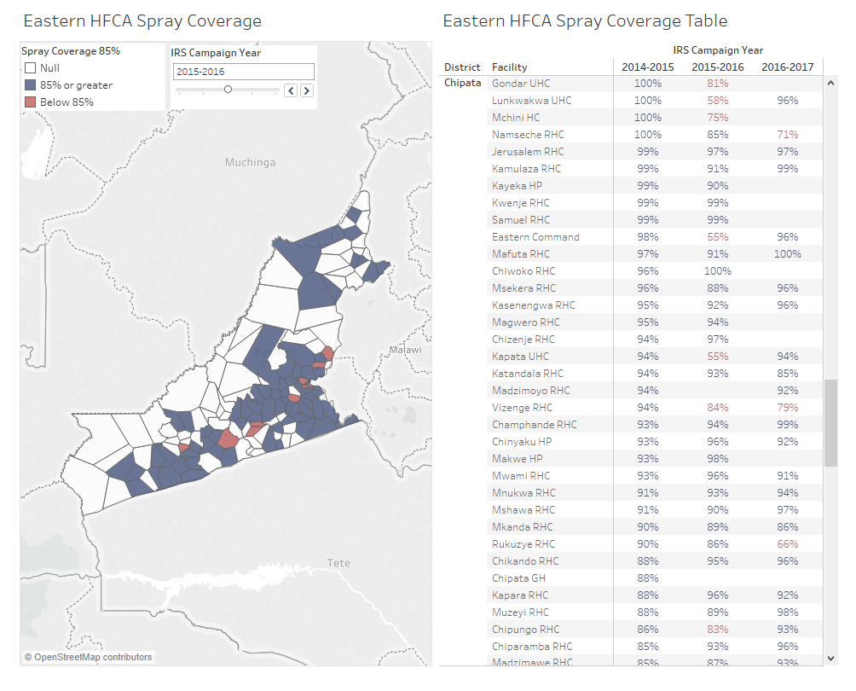
Improving IRS coverage
Notes:
The next shot focuses on spray coverage. In Zambia we have incorporated the coverage data from the government and the non-government spray programs. With this visualization I wanted to highlight 2 features of the dashboards that we have put together. First is that in this view you can explore the data to sub-district levels – to the HFCA. And second the color coding used to highlight whether or not spray targets were met to quickly give a sense of where there were gaps in coverage. On the right is a table view with detailed coverage information over time.
This information about coverage down to the catchment level is intended to support review of past campaign performance towards planning for achieving targets in subsequent campaigns.

Slide 10
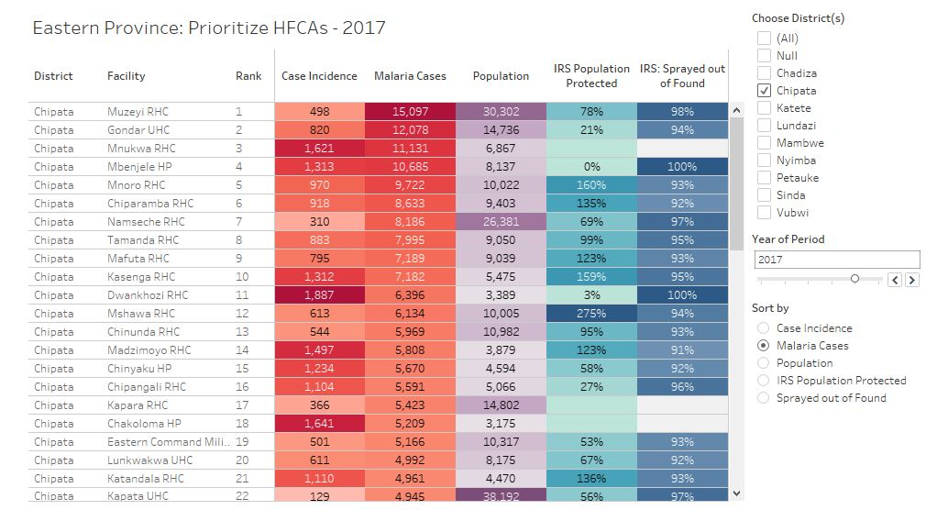
Addressing coverage in high burden and high risk areas
Notes:
The last view I want to show is a visualization that allows for exploring coverage in relation to malaria burden and risk. This visualization is showing health facility catchment areas in Eastern province. I can choose which districts to include using this menu and I can chose the time period. Then I can sort the data. In this view I have sorted data by malaria cases so that I can see which catchments have the highest number of cases, and then I can review IRS coverage in those areas (and risk to be added).
This visualization brings coverage data together with burden and risk to inform decisions. This view could highlight areas with high burden and suboptimal coverage in need of additional intervention. This view can also highlight areas of both high burden and high coverage with existing interventions to inform discussions around what to do next in there areas, including reviewing available insecticide resistance monitoring data or perhaps collecting this type of information if it is not available to inform effective solutions.

Slide 11
Accomplishments & next steps
Accomplishments mid-2018 through early 2019
Stakeholder engagement (Zambia)
Dashboard development (Zambia)
Initial stakeholder engagement in Ethiopia, Nigeria, and Mali
National data review
Evaluation of IRS, next generation LLINs
Next steps in 2019
Complete Zambia dashboards
Facilitate a data review workshop (Zambia)
Develop a vector control data use case study (Zambia)
Continue stakeholder engagement in new countries

Slide 12
Questions Thank you: Sarah Burnett & Jonathan Drummey, PATH Contact: Megan Littrell at mlittrell@path.org
RBM Partnership to End Malaria
3rd floor, TCS Building, Chemin de Blandonnet 2, 1214 Vernier, Geneva, Switzerland. Info@rollbackmalaria.com
Presentation Title
28 January 2019

Slide 13
Project challenges
Diverse set of target users and use cases: multiple stakeholders for IRS decision-making
Tracking down all relevant data, particularly older datasets
Source datasets are sometimes not available (reports the only source of data)
Data quality issues
Final reports that do not match source datasets
>100% coverage
Outliers & missing data
Merging using administrative unit names that do not match across files
Change in number of administrative units and administrative boundaries over time (new health facilities, districts, closed facilities)
Defining administrative boundaries, multiple administrative boundaries
7. Population estimates and structure counts
Notes:
This is an additional slide in case we receive questions about project chllenges.

